Slide 1
ZYNRELEF® (bupivacaine and meloxicam) extended-release solution
a dual-acting local anesthetic (DALA)
Clinical, Administration, and Pricing Overview

Slide 2
Table of Contents
Indication ……………………………........ 3
ZYNRELEF Overview …………………... 4
Mechanism of Action ………………........ 6
Clinical Study Results ……………..……. 13
Real-World Evidence ………………........ 53
Dosage and Administration ...…………... 55
Packaging, Storage, and Handling ..…... 59
ZYNRELEF Unit Pricing ……………....... 61
Reimbursement ………………………….. 62
Important Safety Information ………....... 64
© 2023 Heron Therapeutics, Inc.

Slide 3
Indication
ZYNRELEF is indicated in adults for soft tissue or periarticular instillation to produce postsurgical analgesia for up to 72 hours after foot and ankle, small-to-medium open abdominal, and lower extremity total joint arthroplasty surgical procedures.
Limitations of Use: Safety and efficacy have not been established in highly vascular surgeries, such as intrathoracic, large multilevel spinal, and head and neck procedures.
Important Safety Information
WARNING: RISK OF SERIOUS CARDIOVASCULAR AND GASTROINTESTINAL EVENTS
Nonsteroidal anti-inflammatory drugs (NSAIDs) cause an increased risk of serious cardiovascular thrombotic events, including myocardial infarction and stroke, which can be fatal. This risk may occur early in treatment and may increase with duration of use.
ZYNRELEF is contraindicated in the setting of coronary artery bypass graft (CABG) surgery.
NSAIDs cause an increased risk of serious gastrointestinal (GI) adverse events including bleeding, ulceration, and perforation of the stomach or intestines, which can be fatal. These events can occur at any time during use and without warning symptoms. Elderly patients and patients with a prior history of peptic ulcer disease and/or GI bleeding are at greater risk for serious GI events.
© 2023 Heron Therapeutics, Inc.

Slide 4
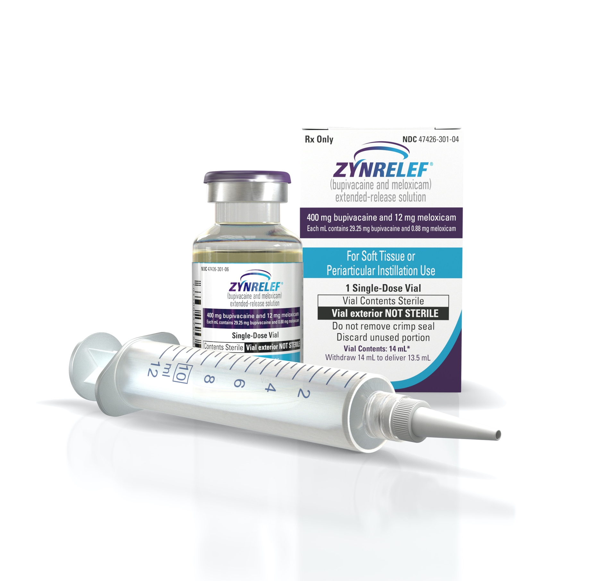
ZYNRELEF Overview
ZYNRELEF is the first and only extended-release dual-acting local anesthetic (DALA)¹⁻⁴
It is also the only local anesthetic considered by FDA to be extended-release, based on superiority to bupivacaine through 72 hours¹
ZYNRELEF is a fixed-dose combination of the local anesthetic bupivacaine and a low dose of the nonsteroidal anti-inflammatory drug meloxicam in the proprietary Biochronomer® polymer¹⁻⁴
ZYNRELEF is a clear, pale yellow to yellow, viscous liquid; it is administered as a single dose and applied without a needle into the surgical site following final irrigation and suction and prior to suturing¹
References: 1. ZYNRELEF [package insert]. San Diego, CA: Heron Therapeutics Inc; 2021. 2. Viscusi E, Gimbel JS, Pollack RA, et al. Reg Anesth Pain Med. 2019;44(7):700-706. 3. Viscusi E, Minkowitz H, Winkle P, et al. Hernia. 2019;23(6):1071-1080. 4. Lachiewicz PF, Lee G-C, Pollak R, et al. J Arthroplasty. 2020;35(10):2843-2851.
© 2023 Heron Therapeutics, Inc.

Slide 5
ZYNRELEF Overview (cont)
ZYNRELEF has been clinically proven to manage postoperative pain better than standard-of-care bupivacaine HCl solution through 72 hours, including fewer patients with severe pain, and to reduce or even eliminate opioid utilization following surgery¹⁻³
ZYNRELEF has demonstrated superior efficacy against standard-of-care bupivacaine HCl solution and placebo across multiple and varied surgical models, including both orthopedic and soft tissue models, making it the only local anesthetic to demonstrate superiority to bupivacaine HCl solution in Phase 3 trials¹⁻³
ZYNRELEF was approved by the FDA on May 12, 2021; it is the only pain drug to have been granted Fast Track, Breakthrough Therapy, and Priority Review designations by the FDA⁴
With the recent approval of the sNDA in December 2021, ZYNRELEF’s indication has significantly expanded
ZYNRELEF is now indicated for foot and ankle, small-to-medium open abdominal, and lower extremity total joint arthroplasty surgical procedures.
The sNDA was approved just 7 months after the initial approval of ZYNRELEF and just 2 months after sNDA submission
No new studies were needed for the approval of the sNDA
References: 1. ZYNRELEF [package insert]. San Diego, CA: Heron Therapeutics Inc; 2021. 2. Viscusi E, Gimbel JS, Pollack RA, et al. Reg Anesth Pain Med. 2019;44(7):700-706. 3. Viscusi E, Minkowitz H, Winkle P, et al. Hernia. 2019;23(6):1071-1080. 4. Fast Track, Breakthrough Therapy, Accelerated Approval, Priority Review. https://www.fda.gov/ForPatients/Approvals/Fast/default.htm. Accessed March 31, 2021.
© 2023 Heron Therapeutics, Inc.

Slide 6
Inflammation and Postsurgical Pain
Mechanism of Action
Postsurgical pain is greatest during the first 72 hours after surgery¹
Most local anesthetics, including liposomal bupivacaine and formulations delivered via wound infiltration catheters or pumps, inconsistently provide pain relief beyond 12 to 24 hours after surgery²⁻⁷
The primary reason most longer-acting local anesthetics are less effective beyond 12 to 24 hours may be inflammation at the wound site, which increases acidity. Acidity decreases the ability of local anesthetics to penetrate nerve cells and block pain signals.²⁻⁷
ZYNRELEF is the first and only extended-release DALA, with a novel, synergistic mechanism of action designed to overcome the challenges of inflammation at the surgical site⁸⁻¹¹
References: 1. Svensson I, Sjöström B, Haljamäe H. J Pain Symptom Manage. 2000;20(3):193-201. 2. Ali A, Sundberg M, Hansson U, et al. Acta Orthop. 2015;86(3):373-377. 3. Kim J, Burke SM, Kryzanski JT, et al. World Neurosurg. 2016;91:460-467. 4. Data on file. DRG physician survey. San Diego, CA: Heron Therapeutics Inc; 2017. 5. Becker DE, Reed KL. Anesth Prog. 2006;53(3):98-109. 6. Exparel [package insert]. San Diego, CA: Pacira Pharmaceuticals Inc; 2021. 7. Hargreaves KM, Keiser K. Endod Topics. 2002;1(1):26-39. 8. ZYNRELEF [package insert]. San Diego, CA: Heron Therapeutics Inc; 2021. 9. Viscusi E, Gimbel JS, Pollack RA, et al. Reg Anesth Pain Med. 2019;44(7):700-706. 10. Viscusi E, Minkowitz H, Winkle P, et al. Hernia. 2019;23(6):1071-1080. 11. Lachiewicz PF, Lee G-C, Pollak R, et al. J Arthroplasty. 2020;35(10):2843-2851.
© 2023 Heron Therapeutics, Inc.

Slide 7
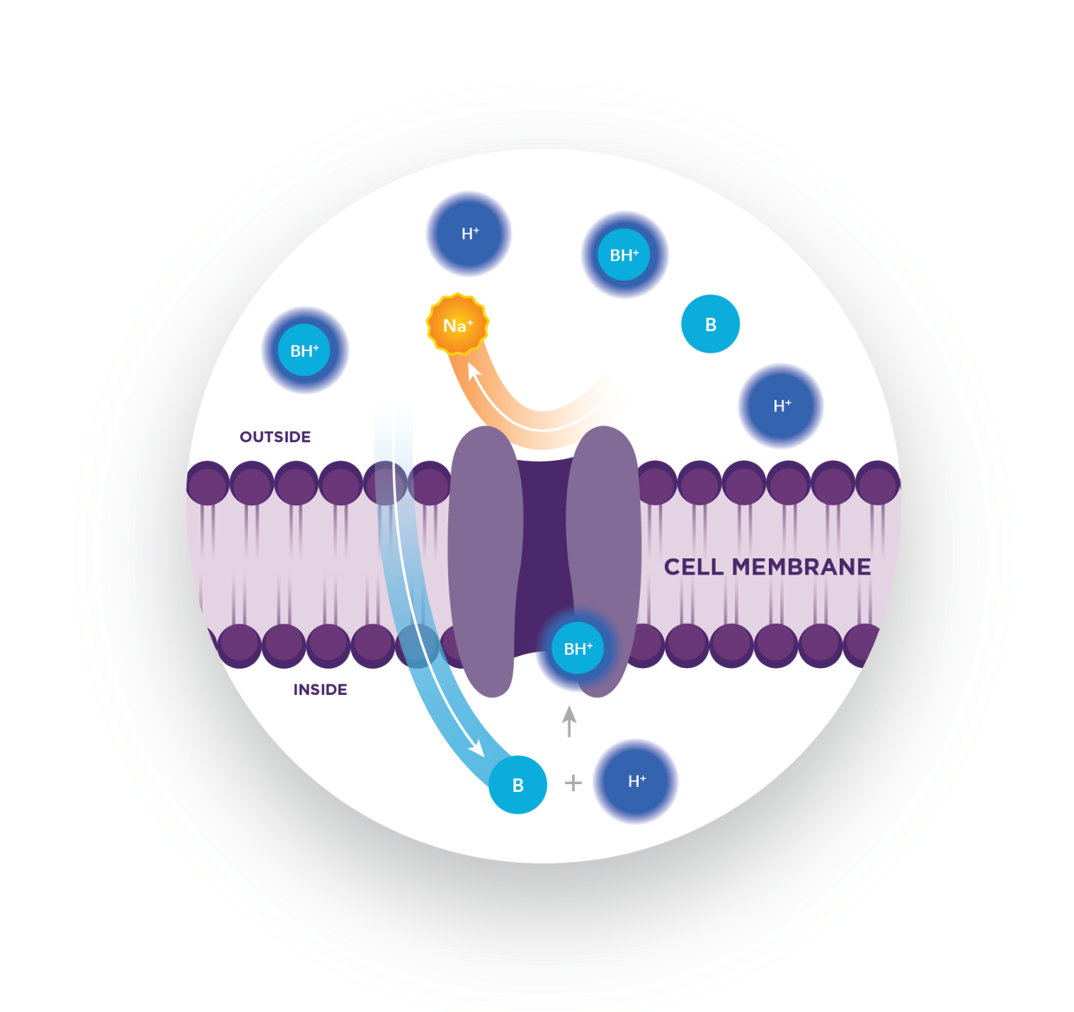
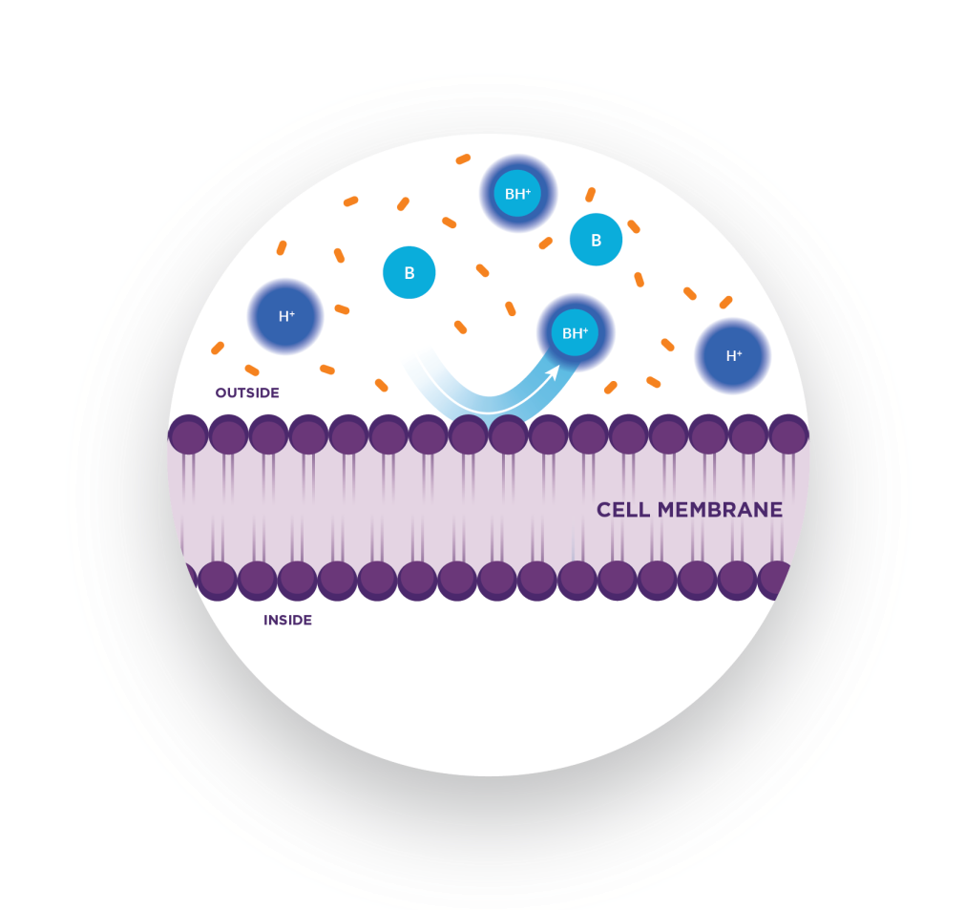
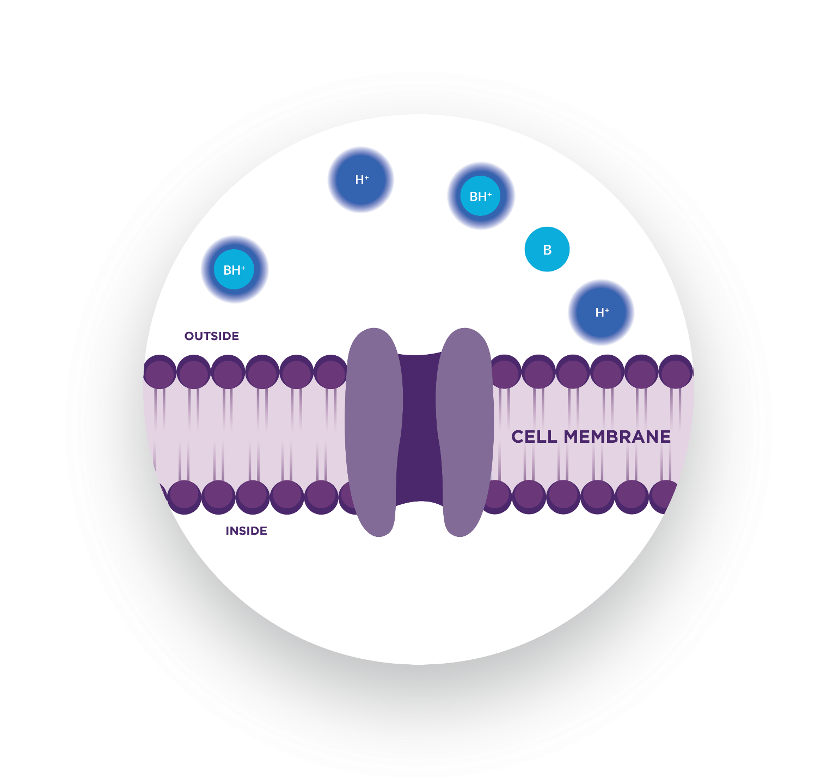
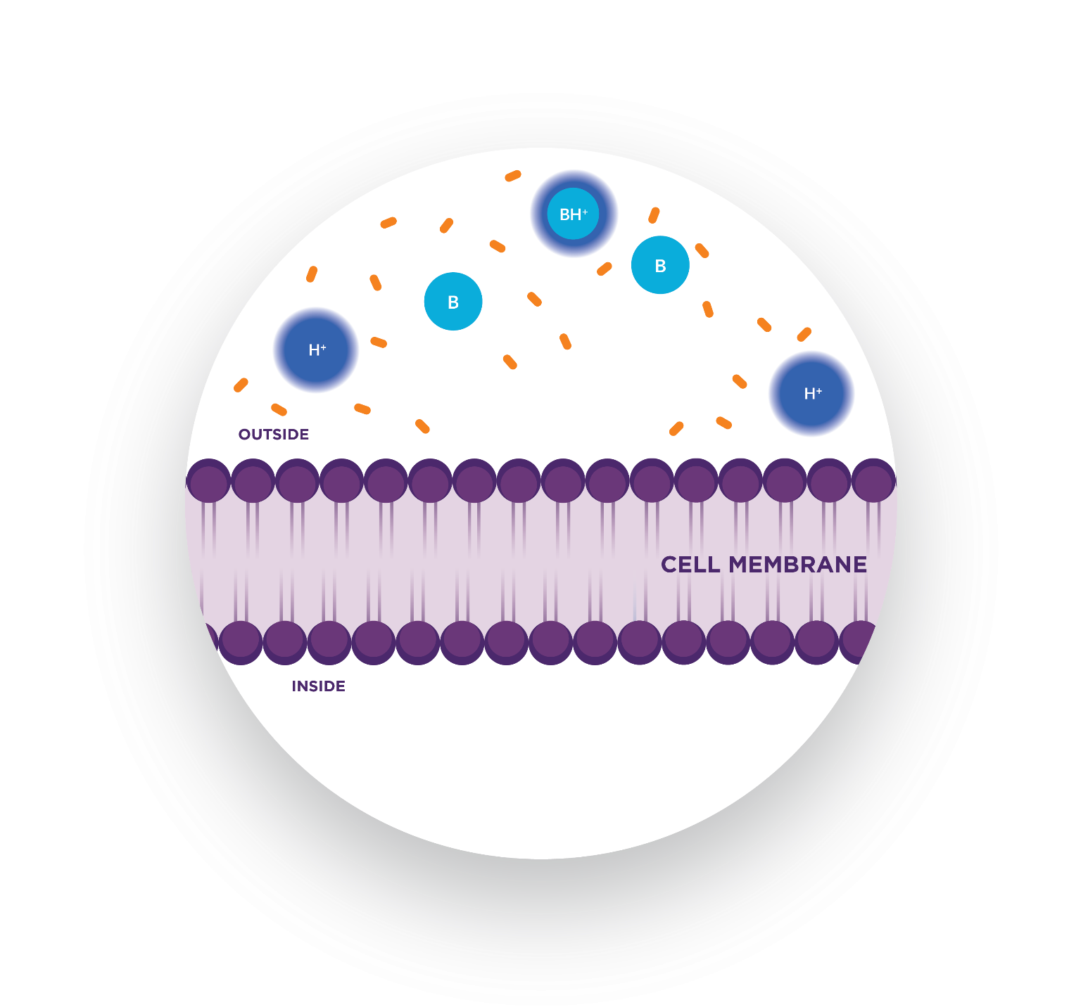
Inflammation Can Inhibit the Efficacy of Local Anesthetics Such as Bupivacaine¹⁻³
Mechanism of Action
Bupivacaine mechanism of action
Impact of inflammation
To stop pain signals, bupivacaine must diffuse through the nerve cell membrane and bind to the voltage-gated sodium ion channels from inside the cell.¹⁻³
Inflammation causes the wound site to become more acidic, resulting in increased ionization of bupivacaine outside the cell.^{2,3} Ionized bupivacaine cannot penetrate the nerve cell membrane and therefore cannot block pain signals.^{2,3}
UN-IONIZED BUPIVACAINE
POSITIVELY CHARGED HYDROGEN ION
IONIZED BUPIVACAINE
ACIDIC METABOLITES
SODIUM ION
References: 1. Berde CB, Strichartz GR. In: Miller RD, Cohen NH, Eriksson LI, et al, eds. Miller’s Anesthesia. Vol 1. 8th ed. Philadelphia, PA: Saunders; 2015:1028-1054.e4. 2. Becker DE, Reed KL. Anesth Prog. 2006;53(3):98-109. 3. Hargreaves KM, Keiser K. Endod Topics. 2002;1(1):26-39.
© 2023 Heron Therapeutics, Inc.

Slide 8
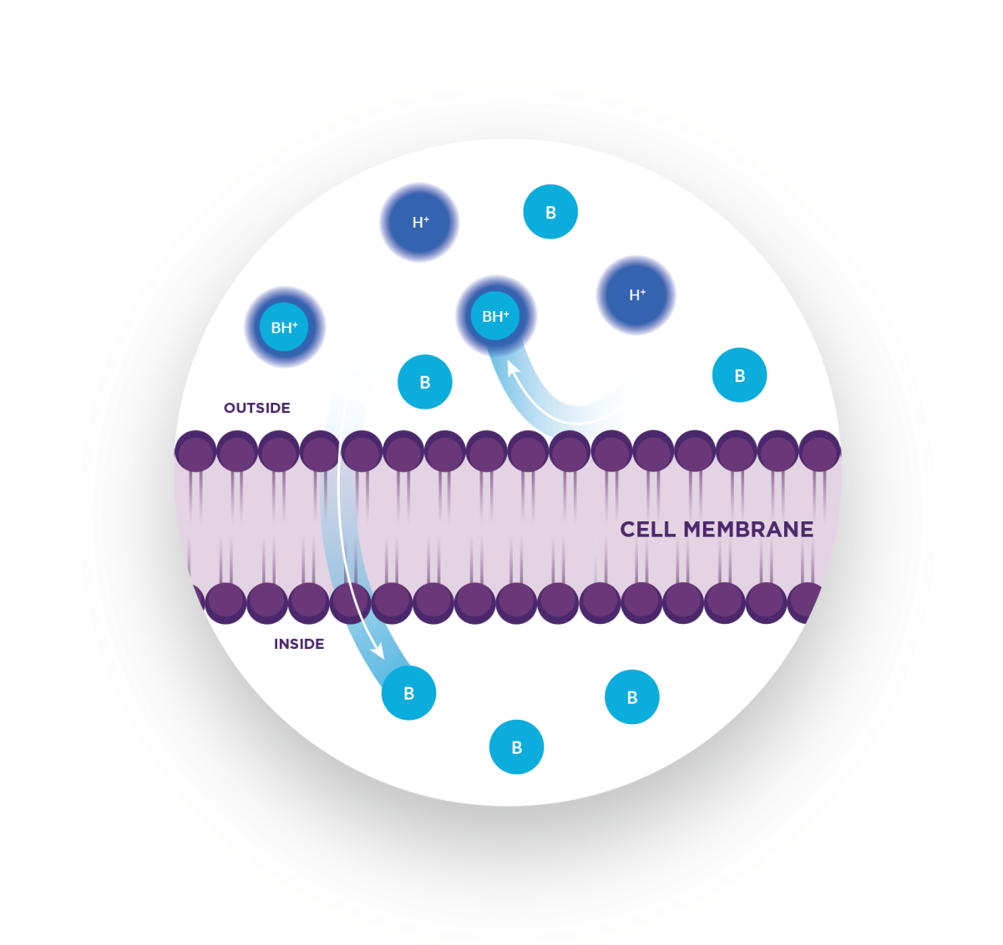
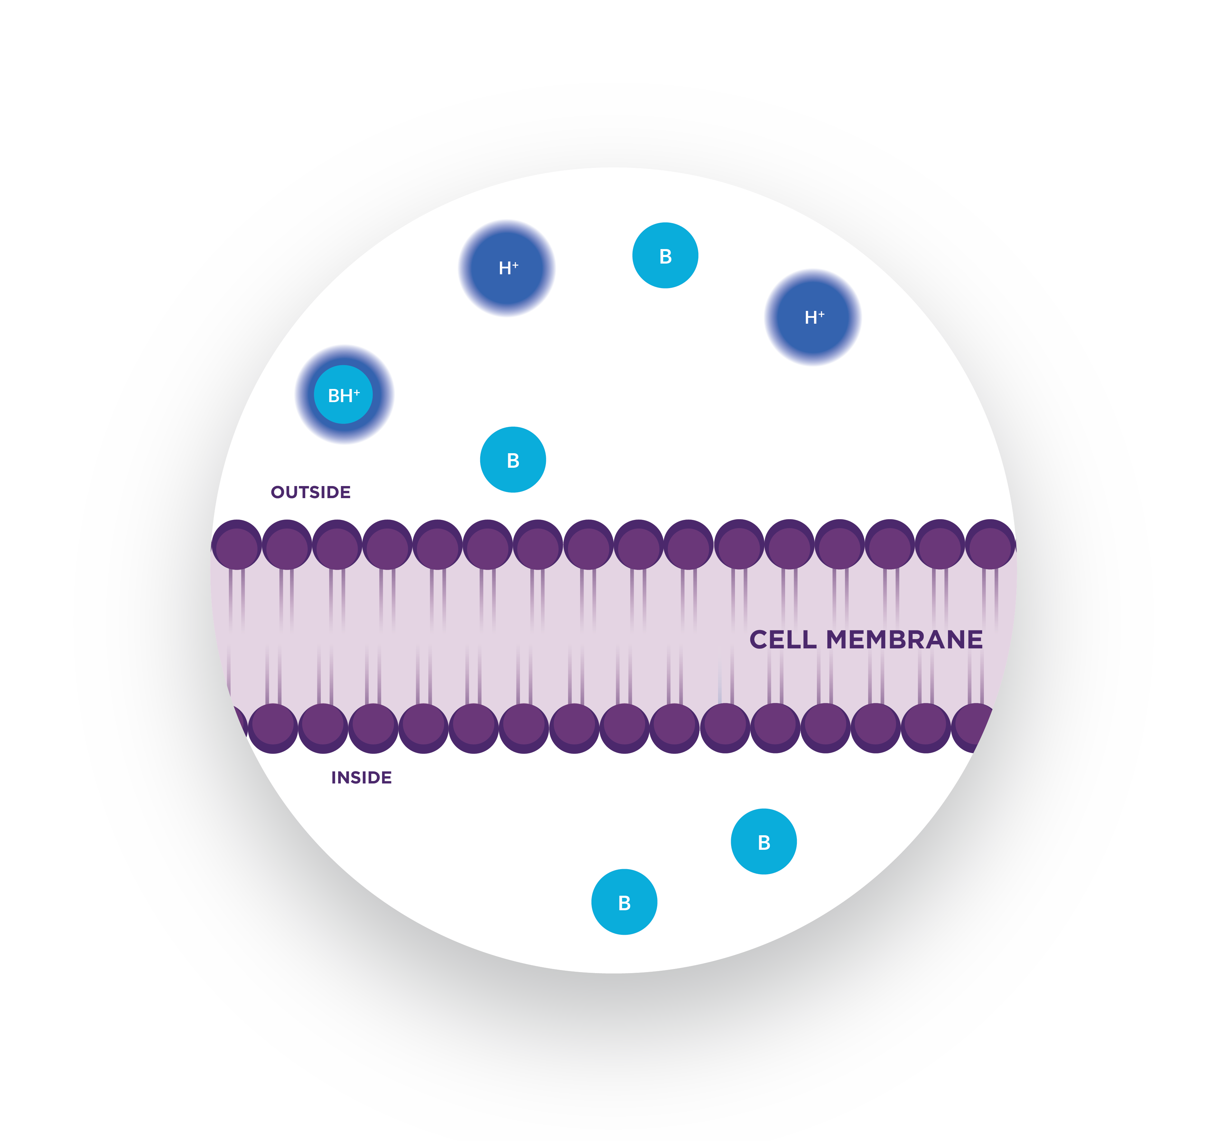
ZYNRELEF: Mechanism of Action
Mechanism of Action
ZYNRELEF is designed to overcome the challenges associated with the local inflammatory process. Novel controlled-diffusion, polymer technology delivers both active ingredients simultaneously for 72 hours.^{1,2}
It is thought that meloxicam in ZYNRELEF inhibits the acidotic effect of inflammation, and as a result reduces the concentration of hydrogen ions in the environment, normalizing the pH at the wound site and potentiating the effect of bupivacaine during the critical 72-hour window when pain is most severe.^{2,3}
In animal studies, ZYNRELEF resulted in decreased tissue acidity (pH 6.87) versus the control group (pH 5.78), which resulted in considerably more un-ionized bupivacaine available to enter nerve cells.^{2,4,a} The synergistic increase in analgesia through 72 hours was seen in a preclinical animal model and confirmed in human studies.^{1,2,4-6}
UN-IONIZED BUPIVACAINE
POSITIVELY CHARGED HYDROGEN ION
IONIZED BUPIVACAINE
ªMeasured at 48 hours post incision.
References: 1. ZYNRELEF [package insert]. San Diego, CA: Heron Therapeutics Inc; 2021. 2. Ottoboni T, Quart B, Pawasauskas J, et al. Reg Anesth Pain Med. 2020;45(2):117-123. 3. Svensson I, Sjöström B, Haljamäe H. J Pain Symptom Manage. 2000;20(3):193-201. 4. Data on file. Study 33-87. San Diego, CA: Heron Therapeutics Inc; 2018. 5. Data on file. Study HTX-011-C2016-208. San Diego, CA: Heron Therapeutics Inc; 2017. 6. Data on file. Study HTX-011-C2015-202. San Diego, CA: Heron Therapeutics Inc; 2018.
© 2023 Heron Therapeutics, Inc.

Slide 9
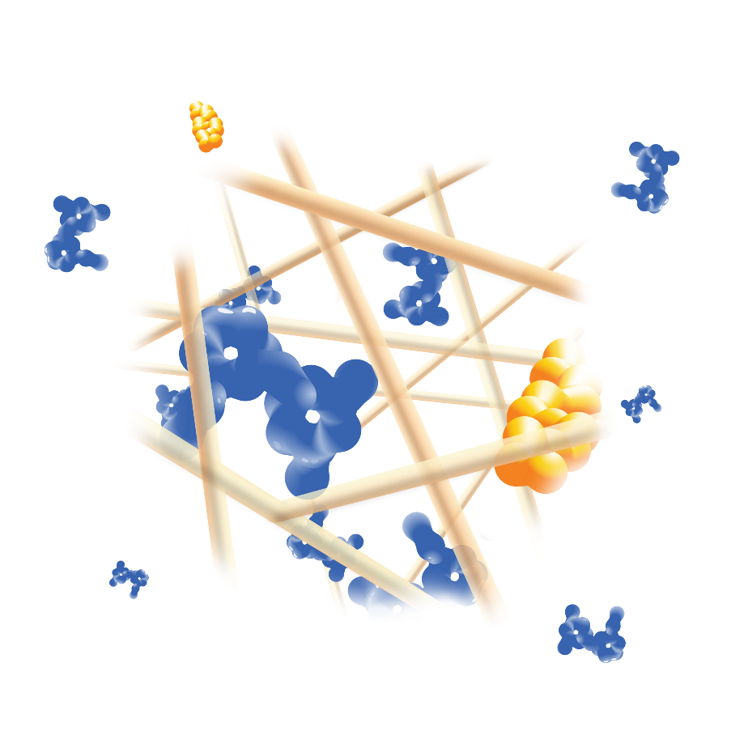
ZYNRELEF Is Formulated and Designed for 72-hour Postoperative Analgesia¹
Mechanism of Action
1. UNIQUE DRUG FORMULATION
2. CONTROLLED DIFFUSION
3. DISSOLUTION
BUPIVACAINE
MELOXICAM
BIOCHRONOMER®
Active ingredients are contained in a novel and proprietary controlled-diffusion polymer called Biochronomer^{1,2}
The ratio of bupivacaine to meloxicam is 33:1¹
Biochronomer is designed for consistently regulated delivery of both active ingredients for 72 hours after surgery^{1,2}
0 to 24 hours: 52% bupivacaine and 44% meloxicam released^{3,a}
0 to 48 hours: 81% bupivacaine and 81% meloxicam released^{3,a}
0 to 72 hours: 93% bupivacaine and 95% meloxicam released^{3,a}
As the active components are released from the formulation, the polymer hydrolyzes into benign, water-soluble end products which are eliminated from the body via the kidneys²
Biochronomer is in a product that has been used approximately 300,000 times^{b} for CINV patients; it has been applied in over 1,500 patients during ZYNRELEF trials^{1,4,5}
ªReflects in vitro release rates of active ingredients. ^{b}Based on units distributed.
CINV: chemotherapy-induced nausea and vomiting.
References: 1. ZYNRELEF [package insert]. San Diego, CA: Heron Therapeutics Inc; 2021. 2. Ottoboni T, Quart B, Pawasauskas J, et al. Reg Anesth Pain Med. 2020;45(2):117-123. 3. Data on file. Summary of biopharmaceutic studies and associated analytical methods. San Diego, CA: Heron Therapeutics Inc; 2018. 4. Data on file. SUSTOL periodic safety update report 07. San Diego, CA: Heron Therapeutics Inc; 2020. 5. Data on file. ZYNRELEF periodic safety update report 01. San Diego, CA: Heron Therapeutics Inc; 2021.
© 2023 Heron Therapeutics, Inc.

Slide 10
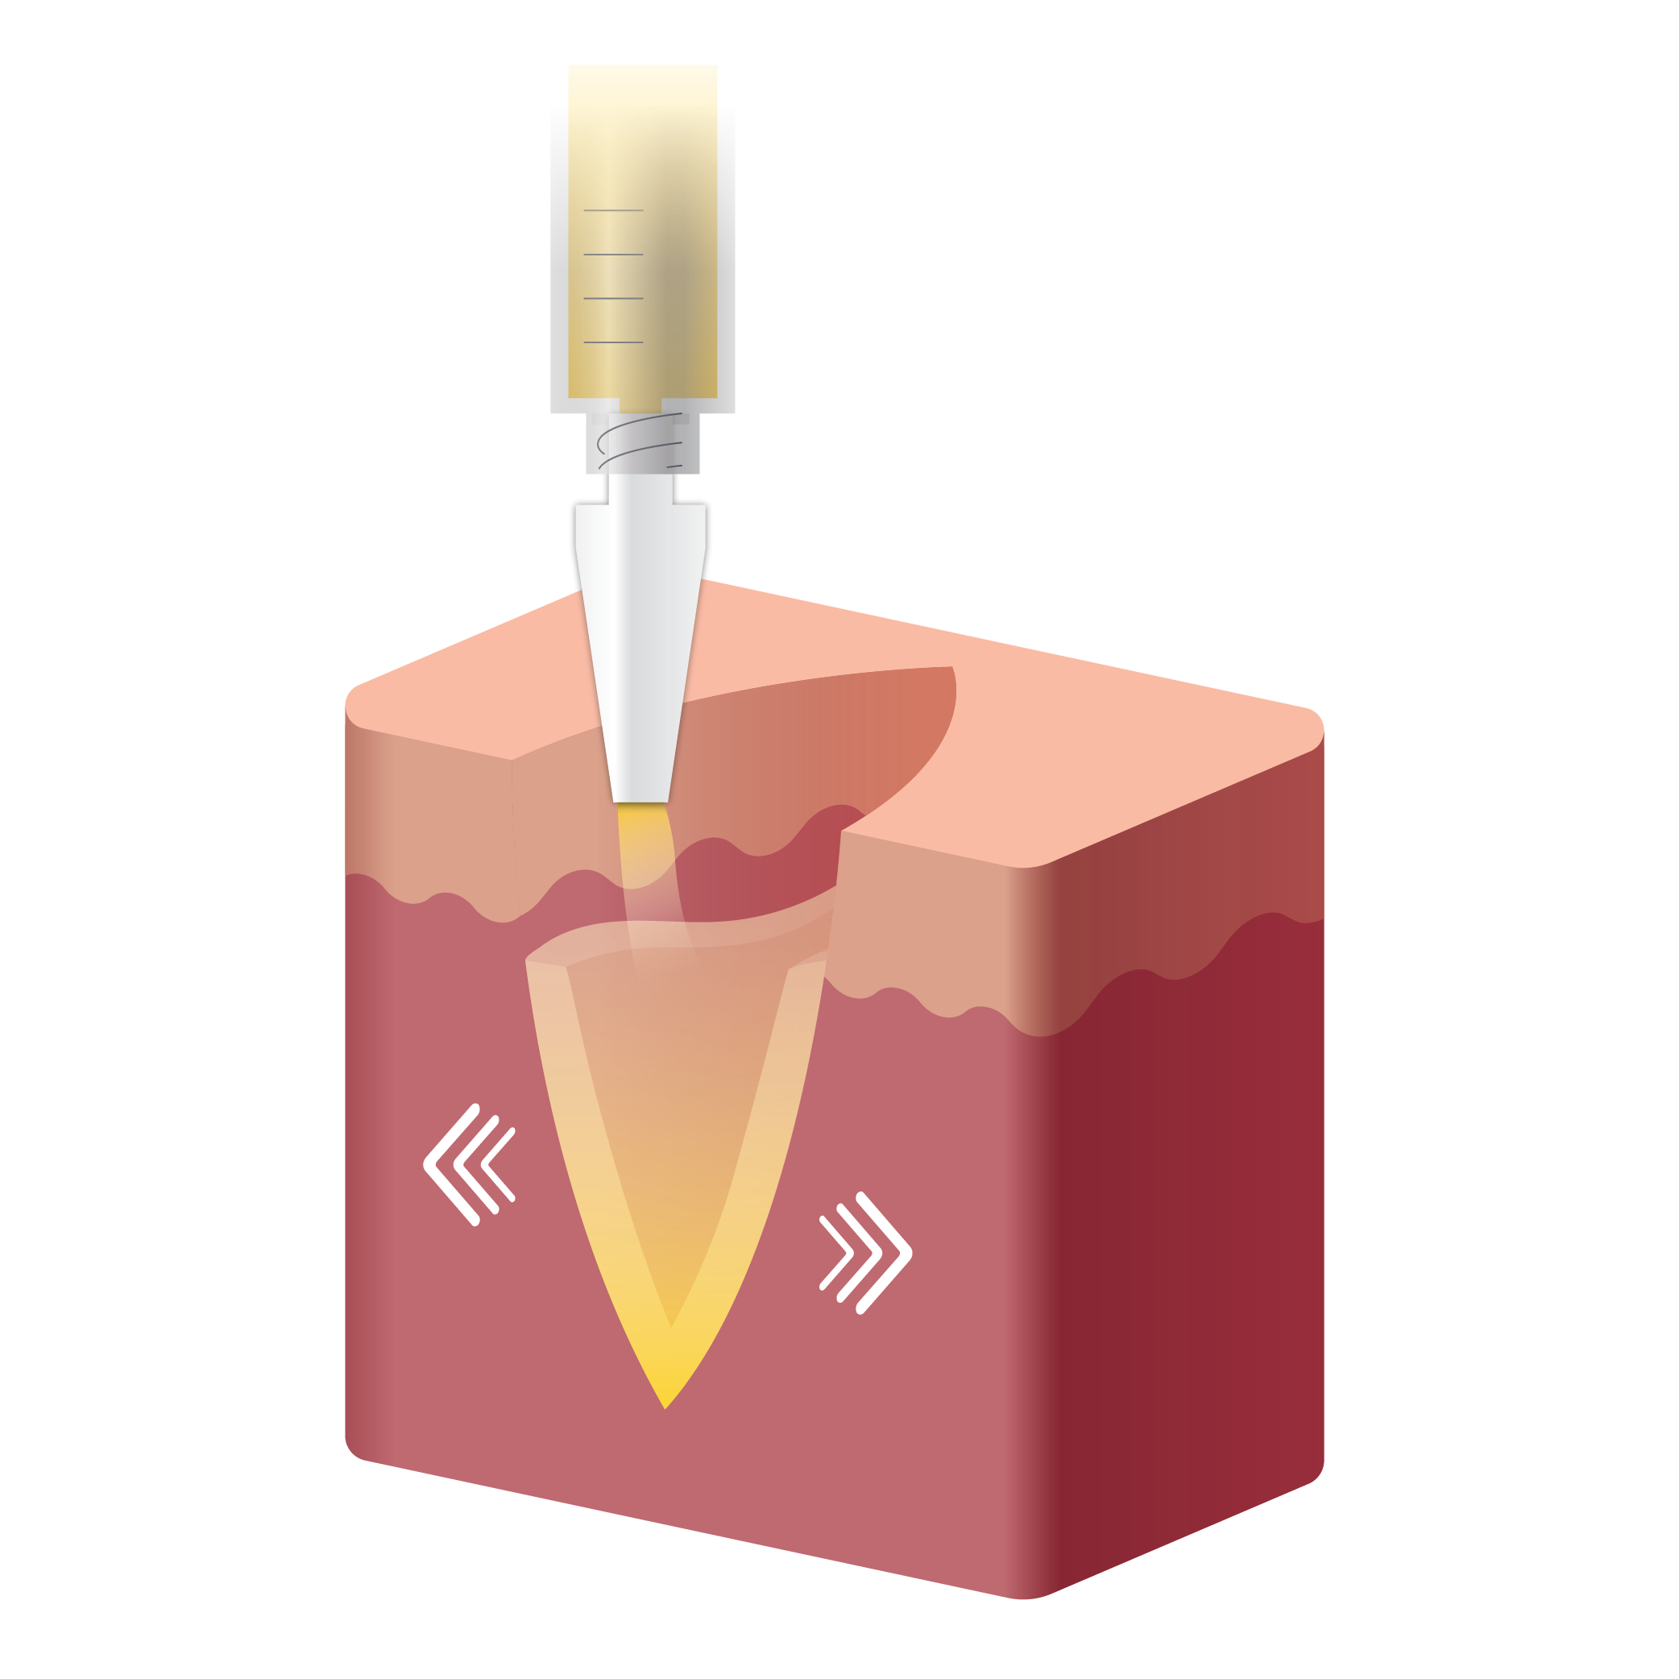
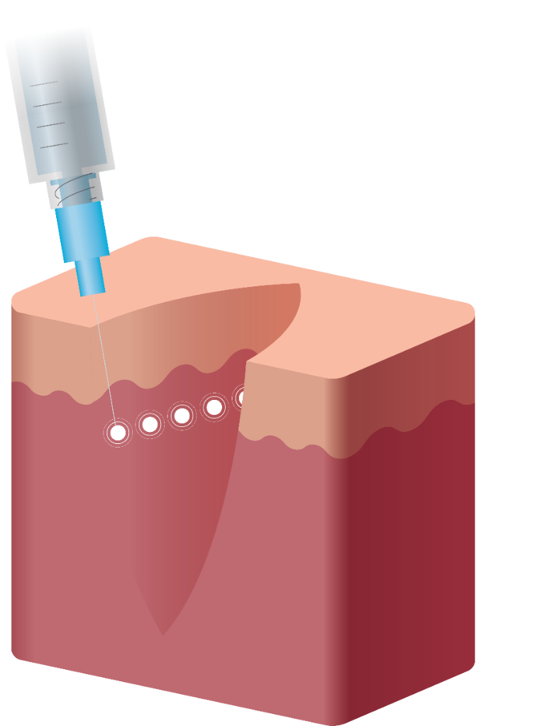
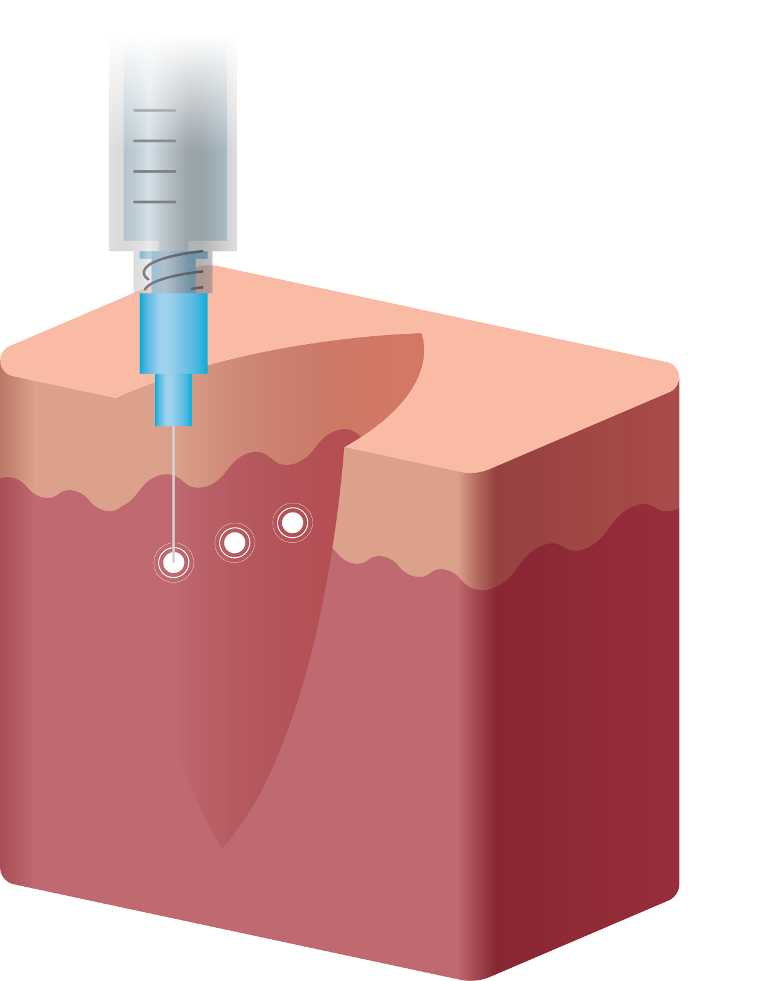
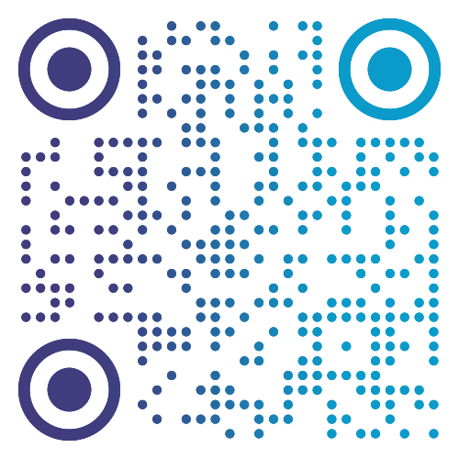
ZYNRELEF Is Applied Without a Needle as a Single Dose¹
Mechanism of Action
Applied via a needle-free syringe to directly coat the affected tissue within the surgical site, following irrigation and suction and prior to suturing; eliminates the need for up to 120 injections, as in total knee arthroplasty^{1,2}
No mixing with bupivacaine is required to achieve efficacy¹
Other local anesthetics can be administered before ZYNRELEF without causing release of the active ingredients all at once^{1,3,4}
BUPIVACAINE HCL SOLUTION²
LIPOSOMAL BUPIVACAINE²
ZYNRELEF¹
To see preparation and administration videos for ZYNRELEF, visit ZYNRELEF.com/admin.
References: 1. ZYNRELEF [package insert]. San Diego, CA: Heron Therapeutics Inc; 2021. 2. Mont MA, Beaver WB, Dysart SH, et al. J Arthroplasty. 2018;33(1):90-96. 3. Viscusi E, Gimbel JS, Pollack RA, et al. Reg Anesth Pain Med. 2019;44(7):700-706. 4. Lachiewicz PF, Lee G-C, Pollak R, et al. J Arthroplasty. 2020;35(10):2843-2851.
© 2023 Heron Therapeutics, Inc.

Slide 11
Mechanism of Action
ZYNRELEF Bupivacaine Plasma Levels and Efficacy Through 72 Hours in Phase 2 Bunionectomy Study¹
PK/PD
Mean Pain Intensity Versus Time
Change in Pain Score
Plasma Bupivacaine
PK/PD: pharmacokinetic/pharmacodynamic.
References: 1. Data on file. Study HTX-011-C2016-208. San Diego, CA: Heron Therapeutics Inc; 2017.
© 2023 Heron Therapeutics, Inc.

Slide 12
Mechanism of Action
ZYNRELEF PK/PD Profiles Are Consistent Through 72 Hours Across Other Surgical Models
Herniorrhaphy¹
Breast Augmentation²
Total Knee Arthroplasty³
ZYNRELEF is not indicated for use in breast augmentation surgery. Data shown here for comparison of PK/PD profiles across surgical models.
PK/PD: pharmacokinetic/pharmacodynamic.
References: 1. Data on file. Study HTX-011-C2015-202. San Diego, CA: Heron Therapeutics Inc; 2018. 2. Data on file. Study HTX-011-211. San Diego, CA: Heron Therapeutics Inc; 2018. 3. Data on file. Study HTX-011-209. San Diego, CA: Heron Therapeutics Inc; 2018.
© 2023 Heron Therapeutics, Inc.

Slide 13
Clinical Portfolio Development¹⁻¹¹
CLINICAL STUDY RESULTS
 | Bunionectomy With Osteotomy (foot and ankle) | Open Inguinal Herniorrhaphy With Mesh (small-to-medium open abdominal) | Total Knee Arthroplasty (lower extremity total joint arthroplasty)
Phase 2a Studies Demonstrating Synergy | Phase 2a (Synergy vs ER bupivacaine and ER meloxicam alone) Study 208 | Phase 2a (Synergy vs ER bupivacaine and ER meloxicam alone) Study 202
RCT Studies Included in PI Did not include non-opioid MMA regimen Included 72-hour in-hospital postoperative monitoring | Phase 3 (vs placebo and bupivacaine) Study 301 | Phase 3 (vs placebo and bupivacaine) Study 302 | Phase 2b (vs placebo and bupivacaine) Study 209
Follow-On Studies Open label, single-arm, uncontrolled Included non-opioid MMA regimen Included 72-hour in-hospital postoperative monitoring | EPOCH 1 Single-Arm Follow-On Study 218 | EPOCH 2 Single-Arm Follow-On Study 215 | EPOCH TKA Single-Arm Follow-On Study 306
Real-World Setting Open label Included non-opioid MMA regimen Discharged per site practice (2.41 hours after surgery on average) |  | HOPE Hernia 1 Study 304
Related Procedures
Based on similarities in surgical site characteristics, such as anatomic location, tissue type, length and depth of surgical area, and vascularity between:
bunionectomy and other foot and ankle surgical procedures
open inguinal herniorrhaphy and other small-to-medium open abdominal surgical procedures
total knee arthroplasty and other lower extremity total joint arthroplasty surgical procedures
the pharmacokinetic profile and effectiveness of ZYNRELEF are not expected to be clinically significantly different when ZYNRELEF is administered at the same dose.¹
RCT: randomized controlled trials. MMA: multimodal analgesia.
References: 1. ZYNRELEF [package insert]. San Diego, CA: Heron Therapeutics Inc; 2021. 2. Data on file. Study HTX-011-C2016-208. San Diego, CA: Heron Therapeutics Inc; 2017. 3. Data on file. Study HTX-011-C2015-202. San Diego, CA: Heron Therapeutics Inc; 2018. 4. Viscusi E, Gimbel JS, Pollack RA, et al. Reg Anesth Pain Med. 2019;44(7):700-706. 5. Viscusi E, Minkowitz H, Winkle P, et al. Hernia. 2019;23(6):1071-1080. 6. Lachiewicz PF, Lee G-C, Pollak R, et al. J Arthroplasty. 2020;35(10):2843-2851. 7. Pollak R, Cai D, Gan TJ. J Am Podiatr Med Assoc. 2021:20-204. doi:10.7547/20-204. 8. Singla N, Winkle P, Bertoch T, et al. Surgery. 2020;168(5):915-920. 9. Hacker S. Poster presented at: Orthopedics Today Hawaii 2020; January 12-16, 2020; Koloa, HI. 10. Fanikos J, Minkowitz H, Reinhorn M, et al. Poster presented at: ASHP 2019 Midyear Clinical Meeting; December 9, 2019; Las Vegas, NV. 11. Data on file. Study HTX-011-304. San Diego, CA: Heron Therapeutics Inc; 2020.
© 2023 Heron Therapeutics, Inc.

Slide 14
EPOCH 1 Bunionectomy: Phase 3 Study Design^{1,2}
EPOCH 1 AND EPOCH 2 RESULTS
Bunionectomy With Osteotomy and Internal Fixation
Screening (28 days)
Treatment and
Inpatient Period
Follow-Up Period
13 sites in the United States
N = 412
Protocol did not include a multimodal analgesic regimen (MMA)
ZYNRELEF 60 mg/1.8 mg
(n = 157)
Bupivacaine HCl 50 mg
(n = 155)
Saline Placebo
(n = 100)
Daily opioid diary
Time 0
(Time of administration)
72 hours (Discharge)
Day 10
(Site visit)
Day 28
(Site visit)
Day 42
(Site visit) Bone and wound healing follow-up
Note: This study was designed to meet regulatory requirements. Patients received postoperative rescue medication (IV morphine, oral oxycodone, and/or non-opioid rescue with oral acetaminophen) only upon request through 72 hours.
MMA: multimodal analgesia.
References: 1. Viscusi E, Gimbel JS, Pollack RA, et al. Reg Anesth Pain Med. 2019;44(7):700-706. 2. ZYNRELEF [package insert]. San Diego, CA: Heron Therapeutics Inc; 2021.
© 2023 Heron Therapeutics, Inc.

Slide 15
EPOCH 2 Herniorrhaphy: Phase 3 Study Design^{1,2}
EPOCH 1 AND EPOCH 2 RESULTS
Open Inguinal Herniorrhaphy
Screening (28 days)
Treatment and
Inpatient Period
Follow-Up Period
16 sites in the United States, 1 site in the European Union
N = 418
Protocol did not include a multimodal analgesic regimen (MMA)
ZYNRELEF 300 mg/9 mg
(n = 164)
Bupivacaine HCl 75 mg
(n = 172)
Saline Placebo
(n = 82)
Daily opioid diary
Time 0
(Time of administration)
72 hours (Discharge)
Day 10
(Site visit)
Day 28
(Site visit)
Note: This study was designed to meet regulatory requirements. Patients received postoperative rescue medication (IV morphine, oral oxycodone, and/or non-opioid rescue with oral acetaminophen) only upon request through 72 hours.
MMA: multimodal analgesia.
References: 1. Viscusi E, Minkowitz H, Winkle P, et al. Hernia. 2019;23(6):1071-1080. 2. ZYNRELEF [package insert]. San Diego, CA: Heron Therapeutics Inc; 2021.
© 2023 Heron Therapeutics, Inc.

Slide 16
ZYNRELEF Met All Primary and Key Secondary Endpoints in Both Phase 3 Trials (EPOCH 1 Bunionectomy and EPOCH 2 Herniorrhaphy)¹⁻³
EPOCH 1 AND EPOCH 2 RESULTS
Hierarchical hypothesis testing
(P ≤ .05)
Endpoint |  | EPOCH 1 Bunionectomy | EPOCH 2 Herniorrhaphy
Primary | Pain Intensity (AUC₀₋₇₂) vs Placebo | P < .0001 | P = .0004
First Key Secondary | Pain Intensity (AUC₀₋₇₂) vs Bupivacaine | P = .0002 | P < .0001
Second Key Secondary | Opioid Use (0-72 hours) vs Placebo | P < .0001 | P = .0001
Third Key Secondary | Opioid-Free (0-72 hours) vs Bupivacaine | P = .0001 | P = .0486
Fourth Key Secondary | Opioid Use (0-72 hours) vs Bupivacaine | P = .0022 | P = .0240
Note: A strict testing hierarchy was applied on the primary and key secondary endpoints to control the study-wise alpha at the .05 level. This means the primary endpoint had to reach significance (P ≤ .05) before the first key secondary endpoint was tested, continuing through each additional key secondary endpoint.
AUC: area under the curve.
References: 1. Viscusi E, Gimbel JS, Pollack RA, et al. Reg Anesth Pain Med. 2019;44(7):700-706. 2. Viscusi E, Minkowitz H, Winkle P, et al. Hernia. 2019;23(6):1071-1080. 3. ZYNRELEF [package insert]. San Diego, CA: Heron Therapeutics Inc; 2021.
© 2023 Heron Therapeutics, Inc.

Slide 17
EPOCH 1 Bunionectomy: Superior Reduction in Pain Intensity Versus SOC Bupivacaine HCl Solution Through 72 Hours, the Time When Postsurgical Pain Is Most Intense¹⁻³
EPOCH 1 AND EPOCH 2 RESULTS
Severe Pain
AUC₀₋₇₂ vs bupivacaine:
P = .0002
AUC₀₋₇₂ vs placebo:
P < .0001
Increasing Pain
Saline Placebo (n = 100)
Bupivacaine HCl Solution 50 mg (n = 155)
ZYNRELEF 60 mg/1.8 mg (n = 157)
Note: Pain scores were analyzed with adjustment for the analgesic duration of rescue medications.
SOC: standard-of-care. NRS-A: Numeric Rating Scale With Activity. AUC: area under the curve.
References: 1. ZYNRELEF [package insert]. San Diego, CA: Heron Therapeutics Inc; 2021. 2. Viscusi E, Gimbel JS, Pollack RA, et al. Reg Anesth Pain Med. 2019;44(7):700-706. 3. Svensson I, Sjöström B, Haljamäe H. J Pain Symptom Manage. 2000;20(3):193-201.
1 2 4 8
© 2023 Heron Therapeutics, Inc.

Slide 18
EPOCH 1 Bunionectomy: Greater Pain Relief Versus SOC Bupivacaine HCl Solution^{1,2}
EPOCH 1 AND EPOCH 2 RESULTS
ZYNRELEF patients reported greater pain relief in the 0-8– and 0-12–hour periods, when bupivacaine is effective²
0-8 and 0-12 hours vs bupivacaine:
AUC₀₋₈: P = .0477ª
AUC₀₋₁₂: P < .0001^{b}
24-72 hours vs bupivacaine:
AUC₂₄₋₇₂: P = .0072ª
Increasing Pain
Saline Placebo (n = 100)
Bupivacaine HCl Solution 50 mg (n = 155)
ZYNRELEF 60 mg/1.8 mg (n = 157)
Even excluding the first 24 hours, ZYNRELEF patients had lower pain intensity through 72 hours²
ªAnalysis not prespecified; nominal P value not controlled for multiplicity.
^{b}Nominal P value not controlled for multiplicity.
Note: Pain scores were analyzed with adjustment for the analgesic duration of rescue medications.
SOC: standard-of-care. NRS-A: Numeric Rating Scale With Activity. AUC: area under the curve.
References: 1. ZYNRELEF [package insert]. San Diego, CA: Heron Therapeutics Inc; 2021. 2. Viscusi E, Gimbel JS, Pollack RA, et al. Reg Anesth Pain Med. 2019;44(7):700-706.
1 2 4 8
© 2023 Heron Therapeutics, Inc.

Slide 19
EPOCH 1 Bunionectomy: Reduction in Pain Intensity (AUC) Versus Placebo Greater Than That of Bupivacaine HCl Through 72 Hours¹⁻³
EPOCH 1 AND EPOCH 2 RESULTS
2.4x
greater pain reduction vs bupivacaine
2.6x
greater pain reduction vs bupivacaine
Greater Pain Reduction vs Placebo
Pain Score—Mean Difference of AUC vs Placebo
2.3x
greater pain reduction vs bupivacaine
AUC for ZYNRELEF
minus AUC for placebo
AUC for bupivacaine minus AUC for placebo
P < .0001ª
P < .0001ª
P = .0002
ªNominal P value not controlled for multiplicity.
Note: Reduction in pain intensity: comparison of pain reduction vs placebo (LSMD of pain intensity score AUC) between groups, adjusting for the use of opioid rescue medication. AUC: area under the curve. LSMD: least squares mean difference.
References: 1. Viscusi E, Gimbel JS, Pollack RA, et al. Reg Anesth Pain Med. 2019;44(7):700-706. 2. ZYNRELEF [package insert]. San Diego, CA: Heron Therapeutics Inc; 2021. 3. Data on file. Study HTX-011-301. San Diego, CA: Heron Therapeutics Inc; 2018.
© 2023 Heron Therapeutics, Inc.

Slide 20
EPOCH 2 Herniorrhaphy: Superior Reduction in Pain Intensity Versus SOC Bupivacaine HCl Solution Through 72 Hours, the Time When Postsurgical Pain Is Most Intense¹⁻³
EPOCH 1 AND EPOCH 2 RESULTS
Severe Pain
AUC₀₋₇₂ vs bupivacaine:
P < .0001
AUC₀₋₇₂ vs placebo:
P = .0004
Increasing Pain
Saline Placebo (n = 82)
Bupivacaine HCl Solution 75 mg (n = 172)
ZYNRELEF 300 mg/9 mg (n = 164)
Note: Pain scores were analyzed with adjustment for the analgesic duration of rescue medications.
SOC: standard-of-care. NRS-A: Numeric Rating Scale With Activity. AUC: area under the curve.
References: 1. ZYNRELEF [package insert]. San Diego, CA: Heron Therapeutics Inc; 2021. 2. Viscusi E, Minkowitz H, Winkle P, et al. Hernia. 2019;23(6):1071-1080. 3. Svensson I, Sjöström B, Haljamäe H. J Pain Symptom Manage. 2000;20(3):193-201.
1 2 4 8
© 2023 Heron Therapeutics, Inc.

Slide 21
EPOCH 2 Herniorrhaphy: Greater Pain Relief Versus SOC Bupivacaine HCl Solution^{1,2}
EPOCH 1 AND EPOCH 2 RESULTS
0-8 and 0-12 hours vs bupivacaine:
AUC₀₋₈: P = .0426ª
AUC₀₋₁₂: P = .0001^{b}
ZYNRELEF patients reported greater pain relief in the 0-8– and 0-12–hour periods, when bupivacaine is effective²
24-72 hours vs bupivacaine:
AUC₂₄₋₇₂: P = .0007ª
Increasing Pain
Saline Placebo (n = 82)
Bupivacaine HCl Solution 75 mg (n = 172)
ZYNRELEF 300 mg/9 mg (n = 164)
Even excluding the first 24 hours, ZYNRELEF patients had lower pain intensity through 72 hours²
ªAnalysis not prespecified; nominal P value not controlled for multiplicity.
^{b}Nominal P value not controlled for multiplicity.
Note: Pain scores were analyzed with adjustment for the analgesic duration of rescue medications.
SOC: standard-of-care. NRS-A: Numeric Rating Scale With Activity. AUC: area under the curve.
References: 1. ZYNRELEF [package insert]. San Diego, CA: Heron Therapeutics Inc; 2021. 2. Viscusi E, Minkowitz H, Winkle P, et al. Hernia. 2019;23(6):1071-1080.
1 2 4 8
© 2023 Heron Therapeutics, Inc.

Slide 22
EPOCH 2 Herniorrhaphy: Reduction in Pain Intensity (AUC) Versus Placebo Greater Than That of Bupivacaine HCl Solution Through 72 Hours¹⁻³
EPOCH 1 AND EPOCH 2 RESULTS
9.1x
5.3x
greater pain reduction vs bupivacaine
greater pain reduction vs bupivacaine
2.7x
Greater Pain Reduction vs Placebo
Pain Score—Mean Difference of AUC vs Placebo
greater pain reduction vs bupivacaine
AUC for ZYNRELEF
minus AUC for placebo
AUC for bupivacaine minus AUC for placebo
P < .0001ª
P < .0001ª
P < .0001ª
ªNominal P value not controlled for multiplicity.
Note: Reduction in pain intensity: comparison of pain reduction vs placebo (LSMD of pain intensity score AUC) between groups, adjusting for the use of opioid rescue medication. AUC: area under the curve. LSMD: least squares mean difference. References: 1. Data on file. Study HTX-011-302. San Diego, CA: Heron Therapeutics Inc; 2018. 2. Viscusi E, Minkowitz H, Winkle P, et al. Hernia. 2019;23(6):1071-1080. 3. ZYNRELEF [package insert]. San Diego, CA: Heron Therapeutics Inc; 2021.
© 2023 Heron Therapeutics, Inc.

Slide 23
More Patients Without Severe Pain Through 72 Hours Versus SOC Bupivacaine HCl Solution
EPOCH 1 AND EPOCH 2 RESULTS
EPOCH 1 Bunionectomy¹
EPOCH 2 Herniorrhaphy²
P < .0001 vs bupivacaineª
P = .0372 vs bupivacaineª
P < .0001 vs placeboª
P < .0001 vs placeboª
Percentage Without Severe Pain Through 72 Hours
Percentage Without Severe Pain Through 72 Hours
ªNominal P value not controlled for multiplicity.
SOC: standard-of-care. Severe pain: pain intensity score ≥7 on a Numeric Rating Scale of 0 to 10.
References: 1. Viscusi E, Gimbel JS, Pollack RA, et al. Reg Anesth Pain Med. 2019;44(7):700-706. 2. Viscusi E, Minkowitz H, Winkle P, et al. Hernia. 2019;23(6):1071-1080.
© 2023 Heron Therapeutics, Inc.

Slide 24
Reduced Opioid Consumption Versus SOC Bupivacaine HCl Solution and Placebo Through 72 Hours
EPOCH 1 AND EPOCH 2 RESULTS
EPOCH 1 Bunionectomy¹
EPOCH 2 Herniorrhaphy²
P = .0022 vs bupivacaine
P = .0240 vs bupivacaine
P < .0001 vs placebo
P = .0001 vs placebo
25%
vs bupivacaine
25%
vs bupivacaine
Mean Total Postoperative Opioid Consumption (MME)
0 Through 72 Hours
Mean Total Postoperative Opioid Consumption (MME)
0 Through 72 Hours
37%
vs placebo
38%
vs placebo
SOC: standard-of-care. MME: morphine milligram equivalents.
References: 1. Viscusi E, Gimbel JS, Pollack RA, et al. Reg Anesth Pain Med. 2019;44(7):700-706. 2. Viscusi E, Minkowitz H, Winkle P, et al. Hernia. 2019;23(6):1071-1080.
© 2023 Heron Therapeutics, Inc.

Slide 25
Significantly More Patients Required No Opioids Through 72 Hours (Opioid-Free) Versus SOC Bupivacaine HCl Solution
EPOCH 1 AND EPOCH 2 RESULTS
EPOCH 1 Bunionectomy^{1,2}
EPOCH 2 Herniorrhaphy^{2,3}
P = .0001 vs bupivacaine
P = .0486 vs bupivacaine
P < .0001 vs placeboª
P < .0001 vs placeboª
Percentage Opioid-Free Through 72 Hours
Percentage Opioid-Free Through 72 Hours
ªNominal P value not controlled for multiplicity.
SOC: standard-of-care.
References: 1. Viscusi E, Gimbel JS, Pollack RA, et al. Reg Anesth Pain Med. 2019;44(7):700-706. 2. ZYNRELEF [package insert]. San Diego, CA: Heron Therapeutics Inc; 2021. 3. Viscusi E, Minkowitz H, Winkle P, et al. Hernia. 2019;23(6):1071-1080.
© 2023 Heron Therapeutics, Inc.

Slide 26
High Percentage of ZYNRELEF Patients Who Were Opioid-Free at 72 Hours Remained Opioid-Free Through Day 28 Recovery
EPOCH 1 AND EPOCH 2 RESULTS
EPOCH 1 Bunionectomy^{1,2}
EPOCH 2 Herniorrhaphy^{2,3}
Of patients in the ZYNRELEF group who were opioid-free at 72 hours …
Of patients in the ZYNRELEF group who were opioid-free at 72 hours …
91%
95%
remained opioid-free through day 10
remained opioid-free through day 10
Percentage Opioid-Free Through 72 Hours
Percentage Opioid-Free Through 72 Hours
82%
85%
remained opioid-free through day 28
remained opioid-free through day 28
References: 1. Viscusi E, Gimbel JS, Pollack RA, et al. Reg Anesth Pain Med. 2019;44(7):700-706. 2. ZYNRELEF [package insert]. San Diego, CA: Heron Therapeutics Inc; 2021. 3. Viscusi E, Minkowitz H, Winkle P, et al. Hernia. 2019;23(6):1071-1080.
© 2023 Heron Therapeutics, Inc.

Slide 27
Incidence of Adverse Reactions¹⁻³
EPOCH 1 AND EPOCH 2 RESULTS
EPOCH 1 Bunionectomy
 | Saline Placebo (n = 101) | Bupivacaine HCl Solution 50 mg (n = 154) | ZYNRELEF 60 mg/1.8 mg (n = 157)
Dizziness | 18% | 23% | 22%
Incision Site Edema | 13% | 14% | 17%
Headache | 10% | 13% | 14%
Incision Site Erythema | 8% | 12% | 13%
Bradycardia | 6% | 8% | 8%
Impaired Healing | 1% | 4% | 6%
Muscle Twitching | 5% | 5% | 6%
Local inflammatory adverse events occurring in ≥2% of patients treated with ZYNRELEF with a higher incidence than with saline placebo included incision site cellulitis (4% incidence with ZYNRELEF, compared to 1% with both bupivacaine HCl solution and saline placebo); wound dehiscence (4% with ZYNRELEF, compared to 1% with bupivacaine HCl solution and 2% with saline placebo); and incision site infection (3% with ZYNRELEF, compared to 1% with bupivacaine HCl solution and 0% with saline placebo).
In EPOCH 1 Bunionectomy, bone healing was assessed by X-ray on days 28 and 42. There was no difference in bone healing between treatment groups. A total of 4 subjects had delayed bone healing: 1 in the ZYNRELEF group, 1 in the saline placebo group, and 2 in the bupivacaine HCl group.
Note: Adverse reactions shown have incidence on ZYNRELEF ≥5% and higher than placebo incidence. Adverse reactions were coded using the Medical Dictionary for Regulatory Activities, Version 19.1. For each preferred term, patients are included only once, even if they experienced multiple events in that preferred term.
References: 1. ZYNRELEF [package insert]. San Diego, CA: Heron Therapeutics Inc; 2021. 2. Viscusi E, Gimbel JS, Pollack RA, et al. Reg Anesth Pain Med. 2019;44(7):700-706. 3. Data on file. Study HTX-011-301. San Diego, CA: Heron Therapeutics Inc; 2018.
© 2023 Heron Therapeutics, Inc.

Slide 28
Incidence of Adverse Reactions¹⁻³
EPOCH 1 AND EPOCH 2 RESULTS
EPOCH 2 Herniorrhaphy
 | Saline Placebo (n = 82) | Bupivacaine HCl Solution 75 mg (n = 173) | ZYNRELEF 300 mg/9 mg (n = 163)
Headache | 12% | 14% | 13%
Bradycardia | 7% | 9% | 9%
Dysgeusia | 4% | 12% | 9%
Skin Odor Abnormal^{4,a} | 1% | 1% | 8%
ªAll incidences of skin odor abnormal were recorded at a single site and by a single observer and are potentially related to the smell of dimethyl sulfoxide (DMSO) in ZYNRELEF.^{2,4}
Note: Adverse reactions shown have incidence on ZYNRELEF ≥5% and higher than placebo incidence. Adverse reactions were coded using the Medical Dictionary for Regulatory Activities, Version 19.1. For each preferred term, patients are included only once, even if they experienced multiple events in that preferred term.
References: 1. ZYNRELEF [package insert]. San Diego, CA: Heron Therapeutics Inc; 2021. 2. Data on file. Study HTX-011-302. San Diego, CA: Heron Therapeutics Inc; 2018. 3. Viscusi E, Minkowitz H, Winkle P, et al. Hernia. 2019;23(6):1071-1080. 4. Tutolo M, Ammirati E, Castagna G, et al. Int Braz J Urol. 2017;43(1):134-141.
© 2023 Heron Therapeutics, Inc.

Slide 29
Lower Overall Incidence of Opioid-Related Adverse Events (ORAEs) Compared to Saline Placebo and Bupivacaine HCl Solution¹⁻⁴
EPOCH 1 AND EPOCH 2 RESULTS
Patients Reporting at Least 1 Opioid-Related Treatment-Emergent Adverse Event
 | Saline Placebo | Bupivacaine HCl Solution | ZYNRELEF
EPOCH 1 Bunionectomy^{1,2} | 53% | 51% | 44%
EPOCH 2 Herniorrhaphy^{3,4} | 44% | 42% | 33%
ORAEs were defined as nausea, vomiting, constipation, pruritus, pruritus generalized, somnolence, respiratory depression, and urinary retention.
References: 1. Viscusi E, Gimbel JS, Pollack RA, et al. Reg Anesth Pain Med. 2019;44(7):700-706. 2. Data on file. Study HTX-011-301. San Diego, CA: Heron Therapeutics Inc; 2018. 3. Viscusi E, Minkowitz H, Winkle P, et al. Hernia. 2019;23(6):1071-1080. 4. Data on file. Study HTX-011-302. San Diego, CA: Heron Therapeutics Inc; 2018.
© 2023 Heron Therapeutics, Inc.

Slide 30
Phase 3 Safety Data Summary
EPOCH 1 AND EPOCH 2 RESULTS
ZYNRELEF has a similar safety profile to that of bupivacaine HCl solution and placebo¹⁻⁵
ZYNRELEF was generally well tolerated with:
No premature discontinuations due to drug-related adverse events^{2,3}
No deaths^{2,3}
Comparable or fewer overall opioid-related adverse events versus placebo and bupivacaine HCl solution^{2,3}
No evidence of drug-related local anesthetic systemic toxicity (LAST)^{2,3}
No evidence of delayed bone healing compared to bupivacaine HCl solution^{1,2}
References: 1. ZYNRELEF [package insert]. San Diego, CA: Heron Therapeutics Inc; 2021. 2. Viscusi E, Gimbel JS, Pollack RA, et al. Reg Anesth Pain Med. 2019;44(7):700-706. 3. Viscusi E, Minkowitz H, Winkle P, et al. Hernia. 2019;23(6):1071-1080. 4. Data on file. Study HTX-011-301. San Diego, CA: Heron Therapeutics Inc; 2018. 5. Data on file. Study HTX-011-302. San Diego, CA: Heron Therapeutics Inc; 2018.
© 2023 Heron Therapeutics, Inc.

Slide 31
EPOCH 1 Single-Armª Follow-On (Bunionectomy): Study Design¹
EPOCH 1 and EPOCH 2 SINGLE-ARM Follow-On Results
Bunionectomy With Osteotomy and Internal Fixation
Screening (28 days)
Treatment and
Inpatient Period
Follow-Up Period
2 sites in the United States
n = 31
Protocol included an oral non-opioid MMA regimen
Study did not include comparator arms; superiority to SOC and placebo demonstrated in EPOCH 1 Bunionectomy^{2,3}
ZYNRELEF
up to 60 mg/1.8 mg + OTC^{b}
Daily opioid diary
Time 0
(Time of administration)
72 hours (Discharge)
Day 7
(Site visit)
Day 28
(Site visit)
Day 42
(Site visit) Bone and wound healing follow-up
Following administration of ZYNRELEF, if additional NSAID medication is indicated in the postoperative period, monitor patients for signs and symptoms of NSAID-related GI adverse reactions.
ªSingle-arm, open-label, uncontrolled study. ZYNRELEF was given with a scheduled non-opioid MMA regimen. ^{b}OTC = Scheduled postoperative analgesic regimen of oral ibuprofen 600 mg q6h, then 3 hours later oral acetaminophen 1 g q6h, alternating for 72 hours, then as needed. SOC: standard-of-care. MMA: multimodal analgesia. OTC: over-the-counter. q6h: every 6 hours. References: 1. Pollak R, Cai D, Gan TJ. J Am Podiatr Med Assoc. 2021:20-204. doi:10.7547/20-204. 2. Viscusi E, Gimbel JS, Pollack RA, et al. Reg Anesth Pain Med. 2019;44(7):700-706. 3. ZYNRELEF [package insert]. San Diego, CA: Heron Therapeutics Inc; 2021.
© 2023 Heron Therapeutics, Inc.

Slide 32
EPOCH 2 Single-Armª Follow-On (Herniorrhaphy): Study Design¹
EPOCH 1 and EPOCH 2 SINGLE-ARM Follow-On Results
Open Inguinal Herniorrhaphy
Screening (21 days)
Treatment and
Inpatient Period
Follow-Up Period
3 sites in the United States
n = 33
Protocol included an oral non-opioid MMA regimen
Study did not include comparator arms; superiority to SOC and placebo demonstrated in EPOCH 2 Herniorrhaphy^{2,3}
ZYNRELEF
300 mg/9 mg + OTC^{b}
Daily opioid diary
Time 0
(Time of administration)
72 hours (Discharge)
Day 10
(Site visit)
Day 28
(Site visit)
Following administration of ZYNRELEF, if additional NSAID medication is indicated in the postoperative period, monitor patients for signs and symptoms of NSAID-related GI adverse reactions.
ªSingle-arm, open-label, uncontrolled study. ZYNRELEF was given with a scheduled non-opioid MMA regimen. ^{b}OTC = Scheduled postoperative analgesic regimen of oral ibuprofen 600 mg q6h, then 3 hours later oral acetaminophen 1 g q6h, alternating for 72 hours, then as needed. Note: Study was comprised of 2 cohorts. The Cohort 2 patients (n = 30) received the same OTC oral analgesics as Cohort 1 (n = 33), as well as a dose of IV ketorolac intraoperatively. The addition of IV ketorolac provided no additional benefit beyond oral acetaminophen and ibuprofen.³ Figures on the subsequent efficacy slides reflect results from Cohort 1. SOC: standard-of-care. MMA: multimodal analgesia. OTC: over-the-counter. q6h: every 6 hours. IV: intravenous. References: 1. Singla N, Winkle P, Bertoch T, et al. Surgery. 2020;168(5):915-920. 2. Viscusi E, Minkowitz H, Winkle P, et al. Hernia. 2019;23(6):1071-1080. 3. ZYNRELEF [package insert]. San Diego, CA: Heron Therapeutics Inc; 2021.
© 2023 Heron Therapeutics, Inc.

Slide 33
EPOCH 1 Single-Armª Follow-On: In Bunionectomy, ZYNRELEF Plus a Scheduled Regimen of Oral Non-Opioid OTC Analgesics Kept Pain in the Mild Range Through 72 Hours¹⁻³
EPOCH 1 and EPOCH 2 Single-Arm Follow-On Results
Severe Pain
EPOCH 1 Study^{b} Did not include the scheduled analgesic regimen
Saline Placebo (n = 100)
Bupivacaine HCl Solution 50 mg (n = 155)
ZYNRELEF 60 mg/1.8 mg (n = 157)
Increasing Pain
ZYNRELEF up to 60 mg/1.8 mg + OTC^{c} (n = 31)
Follow-On Study
ªSingle-arm, open-label, uncontrolled study. ZYNRELEF was given with a scheduled non-opioid MMA regimen. ^{b}EPOCH 1 had similar entry/exclusion criteria to that of the follow-on study but did not include the scheduled analgesic regimen. ^{c}EPOCH 1 Single-Arm Follow-On study included a scheduled regimen of readily available oral analgesics (acetaminophen and ibuprofen).
Note: Pain scores were analyzed with adjustment for the analgesic duration of rescue medications. OTC: over-the-counter. NRS: Numeric Rating Scale. MMA: multimodal analgesia. References: 1. Viscusi E, Gimbel JS, Pollack RA, et al. Reg Anesth Pain Med. 2019;44(7):700-706. 2. Pollak R, Cai D, Gan TJ. J Am Podiatr Med Assoc. 2021:20-204. doi:10.7547/20-204. 3. ZYNRELEF [package insert]. San Diego, CA: Heron Therapeutics Inc; 2021.
Mild Pain
1 4 8
© 2023 Heron Therapeutics, Inc.

Slide 34
EPOCH 2 Single-Armª Follow-On: In Herniorrhaphy, ZYNRELEF Plus a Scheduled Regimen of Oral Non-Opioid OTC Analgesics Kept Pain in the Mild Range Through 72 Hours¹⁻⁵
EPOCH 1 and EPOCH 2 Single-Arm Follow-On Results
Severe Pain
EPOCH 2 Study^{b} Did not include the scheduled analgesic regimen
Saline Placebo (n = 82)
Bupivacaine HCl Solution 75 mg (n = 172)
ZYNRELEF 300 mg/9 mg (n = 164)
Increasing Pain
Follow-On Study
ZYNRELEF 300 mg/9 mg + OTC^{c} (n = 33)
ªSingle-arm, open-label, uncontrolled study. ZYNRELEF was given with a scheduled non-opioid MMA regimen. ^{b}EPOCH 2 had similar entry/exclusion criteria to that of the follow-on study but did not include the scheduled analgesic regimen. ^{c}EPOCH 2 results reflect reported pain intensity with activity (after sitting up from a resting position); EPOCH 2 Follow-On study results reflect reported pain intensity at rest. EPOCH 2 Single-Arm Follow-On study included a scheduled regimen of readily available oral analgesics (acetaminophen and ibuprofen); Cohort 1 in the EPOCH 2 Follow-On study was used for analysis because addition of IV ketorolac provided no additional benefit beyond oral acetaminophen and ibuprofen. Note: Pain scores were analyzed with adjustment for the analgesic duration of rescue medications. OTC: over-the-counter. NRS: Numeric Rating Scale. MMA: multimodal analgesia. References: 1. Viscusi E, Minkowitz H, Winkle P, et al. Hernia. 2019;23(6):1071-1080. 2. Data on file. Study HTX-011-302. San Diego, CA: Heron Therapeutics Inc; 2018. 3. Singla N, Winkle P, Bertoch T, et al. Surgery. 2020;168(5):915-920. 4. Data on file. Study HTX-011-215. San Diego, CA: Heron Therapeutics Inc; 2019. 5. ZYNRELEF [package insert]. San Diego, CA: Heron Therapeutics Inc; 2021.
Mild Pain
1 4 8
© 2023 Heron Therapeutics, Inc.

Slide 35
ZYNRELEF + OTC Patients Consumed 1.6 and 0.6 MME Through 72 hours in Bunionectomy and Herniorrhaphy, Respectively
EPOCH 1 and EPOCH 2 Single-Arm Follow-On Results
EPOCH 1 Bunionectomy/EPOCH 1 Single-Armª Follow-On¹⁻³
EPOCH 2 Herniorrhaphy/EPOCH 2 Single-Armª Follow-On^{3,4}
Total Postoperative Opioid Consumption (MME)
0 Through 72 Hours
Total Postoperative Opioid Consumption (MME)
0 Through 72 Hours
(n = 100)
Solution 50 mg (n = 155)
60 mg/1.8 mg (n = 157)
up to 60 mg/1.8 mg + OTC^{b} (n = 31)
(n = 82)
Solution 75 mg (n = 172)
300 mg/9 mg (n = 164)
300 mg/9 mg + OTC^{b} (n = 33)
EPOCH 1 Study^{c}
Follow-On Study
EPOCH 2 Study^{c}
Follow-On Study
Did not include the scheduled analgesic regimen
Did not include the scheduled analgesic regimen
ªSingle-arm, open-label, uncontrolled study. ZYNRELEF was given with a scheduled non-opioid MMA regimen. ^{b}EPOCH 1 and EPOCH 2 Single-Arm Follow-On studies included a scheduled regimen of readily available oral analgesics (acetaminophen and ibuprofen); Cohort 1 of the EPOCH 2 Single-Arm Follow-On study was used for analysis as addition of IV ketorolac provided no additional benefit beyond oral acetaminophen and ibuprofen. ^{c}EPOCH 1 and EPOCH 2 had the same entry and exclusion criteria as the follow-on studies but did not include the scheduled analgesic regimen. MME: morphine milligram equivalents. OTC: over-the-counter. References: 1. Viscusi E, Gimbel JS, Pollack RA, et al. Reg Anesth Pain Med. 2019;44(7):700-706. 2. Pollak R, Cai D, Gan TJ. J Am Podiatr Med Assoc. 2021:20-204. doi:10.7547/20-204. 3. Singla N, Winkle P, Bertoch T, et al. Surgery. 2020;168(5):915-920. 4. Viscusi E, Minkowitz H, Winkle P, et al. Hernia. 2019;23(6):1071-1080.
© 2023 Heron Therapeutics, Inc.

Slide 36
77% of Bunionectomy Patients and 91% of Herniorrhaphy Patients Remained Opioid-Free Through 72 Hours and Day 28 Recovery When Treated With ZYNRELEF + OTCª
EPOCH 1 and EPOCH 2 Single-Arm Follow-On Results
EPOCH 1 Bunionectomy/EPOCH 1 Single-Armª Follow-On¹⁻³
EPOCH 2 Herniorrhaphy/EPOCH 2 Single-Armª Follow-On³⁻⁵
77% of patients treated with ZYNRELEF and a scheduled non-opioid oral analgesic regimen required no opioids through day 28²
85% of patients treated with ZYNRELEF and a scheduled non-opioid oral analgesic regimen required no opioids through day 28⁵
Percentage Opioid-Free Through 72 Hours
Percentage Opioid-Free Through
72 Hours
(n = 100)
Solution 50 mg (n = 155)
60 mg/1.8 mg (n = 157)
up to 60 mg/1.8 mg
+ OTC^{b} (n = 31)
(n = 82)
Solution 75 mg (n = 172)
300 mg/9 mg (n = 164)
300 mg/9 mg + OTC^{b} (n = 33)
EPOCH 1 Study^{c}
Follow-On Study
EPOCH 2 Study^{c}
Follow-On Study
Did not include the scheduled analgesic regimen
Did not include the scheduled analgesic regimen
ªSingle-arm, open-label, uncontrolled study. ZYNRELEF was given with a scheduled non-opioid MMA regimen. ^{b}EPOCH 1 and EPOCH 2 Single-Arm Follow-On studies included a scheduled regimen of readily available oral analgesics (acetaminophen and ibuprofen); Cohort 1 of the EPOCH 2 Single-Arm Follow-On study was used for analysis as addition of IV ketorolac provided no additional benefit beyond oral acetaminophen and ibuprofen. ^{c}EPOCH 1 and EPOCH 2 had the same entry and exclusion criteria as the follow-on studies but did not include the scheduled analgesic regimen. OTC: over-the-counter. MMA: multimodal analgesia
References: 1. Viscusi E, Gimbel JS, Pollack RA, et al. Reg Anesth Pain Med. 2019;44(7):700-706. 2. Pollak R, Cai D, Gan TJ. J Am Podiatr Med Assoc. 2021:20-204. doi:10.7547/20-204. 3. ZYNRELEF [package insert]. San Diego, CA: Heron Therapeutics Inc; 2021. 4. Viscusi E, Minkowitz H, Winkle P, et al. Hernia. 2019;23(6):1071-1080. 5. Singla N, Winkle P, Bertoch T, et al. Surgery. 2020;168(5):915-920.
© 2023 Heron Therapeutics, Inc.

Slide 37
Follow-On Studies: Incidence of Treatment-Emergent Adverse Events (TEAEs)
EPOCH 1 and EPOCH 2 Single-Arm Follow-On Results
ZYNRELEF was well tolerated when used concomitantly with acetaminophen and ibuprofen, with no increase in NSAID-related toxicity.
EPOCH 1 Single-Armª Follow-On: Bunionectomy^{1,2}
EPOCH 2 Single-Armª Follow-On: Herniorrhaphy^{3,4}
 | ZYNRELEF up to 60 mg/1.8 mg + OTC Analgesic Regimen (n = 31)
Any AE | 65%
AE Possibly Related to Study Drug | 0
Opioid-Related AE | 29%
Local Inflammatory AE | 3%
Potential LAST-Related AE | 3%
AE Leading to Study Withdrawal | 0
Severe AE | 0
Serious AE | 0
Fatal AE | 0
 | ZYNRELEF 300 mg/9 mg + OTC Analgesic Regimen (n = 33) | ZYNRELEF 300 mg/9 mg + OTC Analgesic Regimen + Ketorolac (n = 30)
Any AE | 36% | 40%
Severe AE | 0 | 3%
Opioid-Related AE | 6% | 17%
Potential LAST-Related AE | 3% | 10%
Serious AE | 0 | 0
AE Leading to Study Withdrawal | 0 | 0
ªSingle-arm, open-label, uncontrolled study. ZYNRELEF was given with a scheduled non-opioid MMA regimen.
AE: adverse event. OTC: over-the-counter. LAST: local anesthetic systemic toxicity. Severe Adverse Event: any adverse event that interrupted daily activity or required systemic drug therapy or treatment. Serious Adverse Event: any adverse event that was life-threatening, resulted in substantial disruption to normal life, caused a birth defect, or required medical intervention. MMA: multimodal analgesia
References: 1. Data on file. Study HTX-011-218. San Diego, CA: Heron Therapeutics Inc; 2019. 2. Pollak R, Cai D, Gan TJ. J Am Podiatr Med Assoc. 2021:20-204. doi:10.7547/20-204. 3. Singla N, Winkle P, Bertoch T, et al. Surgery. 2020;168(5):915-920. 4. Data on file. Study HTX-011-215. San Diego, CA: Heron Therapeutics Inc; 2019.
© 2023 Heron Therapeutics, Inc.

Slide 38
EPOCH TKA: Study Design^{1,2}
EPOCH TKA RESULTS
Total Knee Arthroplasty
Screening (21 days)
Treatment and
Inpatient Period
Follow-Up Period
Preoperatively/Intraoperatively:
Acetaminophen ≤1 g IV x 1
Pregabalin 150 mg PO x 1
Tranexamic acid 1 g IV
Fentanyl 75 µg IVª
ZYNRELEF Administration Technique:
Needle-free instillation of 100 mg/3 mg to posterior capsule and 300 mg/9 mg to remaining tissue
Ropivacaine Administration Technique:
Injection of 50 mg into posterior capsule
Postoperatively:
Only opioid rescue on request
Tranexamic acid 1 g IV x 1
Aspirin 325 mg PO BID
ZYNRELEF 400 mg/12 mg
(n = 58)
15 sites in the United States
N = 222
Protocol did not include a postoperative multimodal analgesic regimen
ZYNRELEF 400 mg/12 mg + Ropivacaine 50 mg
(n = 56)
Bupivacaine HCl 125 mg
(n = 55)
Saline Placebo
(n = 53)
Daily opioid diary
Time 0
(Time of administration)
72 hours (Discharge)
Day 10
(Site visit)
Day 28
(Site visit)
ªAll patients were to receive 75 μg intravenous fentanyl just prior to the end of surgery.
Note: Patients requiring postoperative rescue medication were allowed opioid rescue with IV morphine and/or oral oxycodone.
TKA: total knee arthroplasty. IV: intravenous. PO: by mouth (oral). BID: twice daily.
References: 1. Lachiewicz PF, Lee G-C, Pollak R, et al. J Arthroplasty. 2020;35(10):2843-2851. 2. ZYNRELEF [package insert]. San Diego, CA: Heron Therapeutics Inc; 2021.
© 2023 Heron Therapeutics, Inc.

Slide 39
EPOCH TKA: Hierarchical Testing of Key Endpoints^{1,2}
EPOCH TKA RESULTS
Endpoint |  | P Value
Primary | Pain Intensity (AUC₀₋₄₈) ZYNRELEF 400 mg + Ropivacaine vs Placebo | P < .0001
 | Pain Intensity (AUC₀₋₄₈) ZYNRELEF 400 mg vs Placebo | P = .0002
Key Secondary | Pain Intensity (AUC₀₋₇₂) ZYNRELEF 400 mg + Ropivacaine vs Placebo | P < .0001
 | Pain Intensity (AUC₀₋₇₂) ZYNRELEF 400 mg vs Placebo | P = .0004
Hierarchical hypothesis testing
(P ≤ .05)
In the primary analysis, ZYNRELEF demonstrated statistically superior pain reduction through 48 and 72 hours versus placebo^{1,a}
ªPain scores reported adjusting for opioid rescue medication use.
Note: A strict testing hierarchy was applied on the primary and key secondary endpoints to control the study-wise alpha at the .05 level. This means the primary endpoint had to reach significance (P ≤ .05) before the first key secondary endpoint was tested, continuing through each additional key secondary endpoint.
TKA: total knee arthroplasty. AUC: area under the curve. Placebo: saline placebo.
References: 1. Lachiewicz PF, Lee G-C, Pollak R, et al. J Arthroplasty. 2020;35(10):2843-2851. 2. ZYNRELEF [package insert]. San Diego, CA: Heron Therapeutics Inc; 2021.
© 2023 Heron Therapeutics, Inc.

Slide 40
EPOCH TKA RESULTS
EPOCH TKA: Pain Intensity Score (NRS-R) Through 72 Hours, Adjusting for Opioid Rescue Medication Use^{1,a}
Severe Pain
ZYNRELEF vs placebo:
AUC₀₋₄₈ P = .0002
AUC₀₋₇₂ P = .0004
ZYNRELEF + Ropivacaine vs placebo:
AUC₀₋₄₈ P < .0001
AUC₀₋₇₂ P < .0001
Increasing Pain
Saline Placebo (n = 53)
ZYNRELEF 400 mg/12 mg (n = 58)
ZYNRELEF 400 mg/12 mg + Ropivacaine 50 mg (n = 56)
ªPain scores reported adjusting for opioid rescue medication use.
Mild Pain
TKA: total knee arthroplasty. NRS-R: Numeric Rating Scale at Rest.
References: 1. ZYNRELEF [package insert]. San Diego, CA: Heron Therapeutics Inc; 2021.
Mild Pain
1 4 8
© 2023 Heron Therapeutics, Inc.

Slide 41
EPOCH TKA: Pain Intensity Score (NRS-R) Through 72 Hours Compared to Bupivacaine HCl Solution, Without Adjustment for Opioid Rescue Medication¹
EPOCH TKA RESULTS
ZYNRELEF vs placebo:
AUC₀₋₄₈ P = .0001ª
AUC₀₋₇₂ P = .0001ª
Severe Pain
ZYNRELEF vs bupivacaine:
AUC₀₋₄₈ P = .0070ª
AUC₀₋₇₂ P = .0269ª
Increasing Pain
Saline Placebo (n = 53)
Bupivacaine HCl Solution 125 mg (n = 55)
ZYNRELEF 400 mg/12 mg (n = 58)
ZYNRELEF 400 mg/12 mg + Ropivacaine 50 mg (n = 56)
ªNominal P value not controlled for multiplicity. This analysis is appropriate since ZYNRELEF patients consumed fewer opioids, and is clinically meaningful because it demonstrates that ZYNRELEF patients experienced less pain even while consuming fewer opioids. Analysis represents data from Cohort 2.
TKA: total knee arthroplasty. NRS-R: Numeric Rating Scale at Rest. AUC: area under the curve.
References: 1. Lachiewicz PF, Lee G-C, Pollak R, et al. J Arthroplasty. 2020;35(10):2843-2851. 2. Data on file. Study HTX-011-209. San Diego, CA: Heron Therapeutics Inc; 2018.
Mild Pain
1 4 8
© 2023 Heron Therapeutics, Inc.

Slide 42
EPOCH TKA Secondary Analysis: Greater Pain Reduction With ZYNRELEF¹
EPOCH TKA RESULTS
2.2x greaterª
2.1x greaterª
Pain Intensity Score Mean Difference of AUC vs Placebo
2.3x greaterª
2.2x greaterª
Greater Pain Reduction
AUC for ZYNRELEF + ropivacaine minus AUC for placebo
2.7x greaterª
3.1x greaterª
AUC for ZYNRELEF
minus AUC for placebo
2.3x greaterª
AUC for bupivacaine minus AUC for placebo
ªGreater pain reduction versus placebo than SOC
Note: Comparison of pain reduction versus placebo (LSMD of pain intensity score AUC) between groups without adjustment for opioid rescue medication use. This sensitivity analysis may be a more relevant comparison since patients were not given a multimodal analgesic regimen and almost all received opioids.
TKA: total knee arthroplasty. AUC: area under the curve. SOC: standard-of-care. LSMD: least squares mean difference.
References: 1. Lachiewicz PF, Lee G-C, Pollak R, et al. J Arthroplasty. 2020;35(10):2843-2851.
© 2023 Heron Therapeutics, Inc.

Slide 43
EPOCH TKA RESULTS
EPOCH TKA: Over 50% of ZYNRELEF Patients
“Discharge Ready” by 8 Hours Following Surgery^{1,a}
Discharge readiness was measured according to the MPADSS scale^{2,a}
Proportion of Patients First Achieving MPADSS Score ≥9
ªMPADSS considers numerous clinical variables such as vital signs, ambulation, nausea/vomiting, pain, and surgical bleeding, with patients scoring ≥9 (on a scale of 0 to 10) considered ready for discharge. The proportion of subjects who first achieved an MPADSS score ≥9 at each time point was analyzed cumulatively.
TKA: total knee arthroplasty. MPADSS: Modified Postanesthetic Discharge Scoring System.
References: 1. Lachiewicz PF, Lee G-C, Pollak R, et al. J Arthroplasty. 2020;35(10):2843-2851. 2. Chung F. Can J Anaesth. 1995;42(11):1056-1058.
© 2023 Heron Therapeutics, Inc.

Slide 44
Incidence of Adverse Reactions¹⁻³
EPOCH TKA RESULTS
 | Saline Placebo (n = 53) | Bupivacaine HCl Solution 125 mg (n = 55) | ZYNRELEF 400 mg/12 mg (n = 58)
Nausea | 47% | 55% | 50%
Constipation | 23% | 33% | 24%
Vomiting | 19% | 27% | 26%
Hypertension | 15% | 13% | 19%
Pyrexia | 4% | 15% | 14%
Leukocytosis | 0 | 2% | 7%
Pruritus | 2% | 5% | 7%
Headache | 0 | 7% | 7%
Anemia | 2% | 0 | 5%
Hyperhidrosis | 4% | 0 | 5%
Hypotension | 4% | 2% | 5%
Note: Adverse reactions shown have incidence on ZYNRELEF ≥5% and higher than placebo incidence. Analysis represents data from Cohort 2. The adverse reactions for ZYNRELEF with or without low-dose ropivacaine were similar.
References: 1. ZYNRELEF [package insert]. San Diego, CA: Heron Therapeutics Inc; 2021. 2. Lachiewicz PF, Lee G-C, Pollak R, et al. J Arthroplasty. 2020;35(10):2843-2851. 3. Data on file. Study HTX-011-209. San Diego, CA: Heron Therapeutics Inc; 2018.
© 2023 Heron Therapeutics, Inc.

Slide 45
EPOCH TKA Single-Armª Follow-On Study (ZYNRELEF + Non-Opioid MMA)^{1,2}
EPOCH TKA SINGLE-ARM FOLLOW-ON RESULTS
Total Knee Arthroplasty
Screening (21 days)
Treatment and
Inpatient Period
Follow-Up Period
Pre-op: PO acetaminophen (1 g), PO celecoxib (200 mg), and PO pregabalin (300 mg). Surgery was performed under bupivacaine spinal anesthesia.
Intra-op: Intravenous fentanyl (≤4 μg/kg) permitted. No other opioids, analgesics, or anti-inflammatory agents (except ZYNRELEF) were permitted intraoperatively, unless needed to treat an adverse event, for pretreatment prior to needle placement, or to decrease venous irritation.
Post-op: For the first 3 days, PO acetaminophen (1 g q8h) and PO celecoxib (200 mg q12h). For the next 4 to 7 days, PO ibuprofen (600 mg q6h), then 3 hours later PO acetaminophen (1 g q6h), alternating for 72 hours, then as needed.
6 sites in the United States
n = 51
Protocol included an oral non-opioid postoperative MMA regimen^{b}
ZYNRELEF 400 mg/12 mg + Non-Opioid MMA
Daily opioid diary
Time 0
(Time of administration)
72 hours (Discharge)
Day 11
(Site visit)
Day 29
(Site visit)
Following administration of ZYNRELEF, if additional NSAID medication is indicated in the postoperative period, monitor patients for signs and symptoms of NSAID-related GI adverse reactions.
ªSingle-arm, open-label, uncontrolled study. ZYNRELEF was given with a scheduled non-opioid MMA regimen. ^{b}The MMA regimen and primary endpoint were selected based on a published Phase 4 study of a long-acting liposomal bupivacaine with a scheduled, non-opioid MMA regimen in TKA.³ TKA: total knee arthroplasty. MMA: multimodal analgesia. PO: by mouth (oral). q6h/q8h/q12h: every 6/8/12 hours.
References: 1. Data on file. Study HTX-011-306. San Diego, CA: Heron Therapeutics Inc; 2020. 2. Hacker S. Poster presented at: Orthopedics Today Hawaii 2020; January 12-16, 2020; Koloa, HI. 3. Mont MA, Beaver WB, Dysart SH, et al. J Arthroplasty. 2018;33(1):90-96.
© 2023 Heron Therapeutics, Inc.

Slide 46
EPOCH TKA Single-Armª Follow-On Study: ZYNRELEF Plus Non-Opioid MMA Kept Pain in the Mild Range Through 72 Hours^{1,b}
EPOCH TKA SINGLE-ARM FOLLOW-ON RESULTS
Severe Pain
Increasing Pain
ZYNRELEF 400 mg/12 mg + Non-Opioid MMA (n = 51)
ªSingle-arm, open-label, uncontrolled study. ZYNRELEF was given with a scheduled non-opioid MMA regimen. ^{b}As reported without adjustment for opioid rescue medication use.
Note: Phase 2b data from Cohort 2. Phase 2b study surgeries performed under general anesthesia; follow-on study surgeries performed under bupivacaine spinal anesthesia.
TKA: total knee arthroplasty. MMA: multimodal analgesia. NRS: Numeric Rating Scale.
References: 1. Hacker S. Poster presented at: Orthopedics Today Hawaii 2020; January 12-16, 2020; Koloa, HI.
Mild Pain
1 2 4 8
© 2023 Heron Therapeutics, Inc.

Slide 47
Topline Results of the EPOCH TKA Single-Armª Follow-On Study (ZYNRELEF + MMA)¹
EPOCH TKA SINGLE-ARM FOLLOW-ON RESULTS
The majority of patients rated their pain control as “good” or “excellent”¹
The mean consumption of opioids in the EPOCH TKA Single-Arm Follow-On study was 1 to 2 pills of oxycodone 10 mg per day through 72 hours (25 MME)¹
39% of TKA patients treated with ZYNRELEF and a non-opioid MMA regimen received no opioid discharge prescription and had no callbacks through day 11 of recovery^{1,2}
37% of TKA patients treated with ZYNRELEF and a scheduled non-opioid MMA regimen experienced no severe pain through 72 hours²
88% on day 1
90% on day 2
100% on day 3
ªSingle-arm, open-label, uncontrolled study. ZYNRELEF was given with a scheduled non-opioid MMA regimen.
TKA: total knee arthroplasty. MMA: multimodal analgesia. MME: morphine milligram equivalent. Severe pain: pain intensity score of ≥7 on a Numeric Rating Scale of 0 to 10. References: 1. Data on file. Study HTX-011-306. San Diego, CA: Heron Therapeutics Inc; 2020. 2. Hacker S. Poster presented at: Orthopedics Today Hawaii 2020; January 12-16, 2020; Koloa, HI.
© 2023 Heron Therapeutics, Inc.

Slide 48
EPOCH TKA Single-Armª Follow-On Study: Incidence of Treatment-Emergent Adverse Events¹
EPOCH TKA SINGLE-ARM FOLLOW-ON RESULTS
 | ZYNRELEF 400 mg/12 mg + Non-Opioid MMA Regimen (n = 51)
Any AE | 82%
Nausea | 57%
Vomiting | 27%
Constipation | 20%
Dizziness | 12%
Anemia postoperative | 6%
Bradycardia | 6%
Urinary retention | 6%
ªSingle-arm, open-label, uncontrolled study. ZYNRELEF was given with a scheduled non-opioid MMA regimen.
Note: Events included are AEs with an incidence of ≥5%.
TKA: total knee arthroplasty. AE: adverse event. MMA: multimodal analgesia.
References: 1. Data on file. Study HTX-011-306. San Diego, CA: Heron Therapeutics Inc; 2020.
© 2023 Heron Therapeutics, Inc.

Slide 49
ZYNRELEF as the Foundation of a Non-Opioid MMA Regimen in a Real-World Setting^{1,2}
THE HOPE PROJECT
Patients undergoing open inguinal herniorrhaphy were randomized to 1 of 2 parallel cohorts, each receiving different postoperative non-opioid MMA protocols with ZYNRELEF as the foundation:
Cohort 1 (n = 46): Alternating OTC regimen (ibuprofen 600 mg q6h alternated 3 hours later with acetaminophen 1 g q6h)
Cohort 2 (n = 47): Concurrent OTC regimen (ibuprofen 600 mg and acetaminophen 1 g, taken together q6h)
A simple algorithm was used to identify which patients were more likely to require postoperative opioid pain control³:
Patients with an NRS score ≥6 within 2 hours after surgery
Patients who required any postoperative opioids prior to discharge
This algorithm was prospectively validated in HOPE Hernia 1.
Following administration of ZYNRELEF, if additional NSAID medication is indicated in the postoperative period, monitor patients for signs and symptoms of NSAID-related GI adverse reactions.
Note: The results in this presentation reflect Part 1 of the initial HOPE study in herniorrhaphy. Part 1 of this study was open label, with 2 parallel cohorts receiving different postoperative non-opioid MMA regimens. MMA: multimodal analgesia. OTC: over-the-counter. q6h: every 6 hours. NRS: Numeric Rating Scale. TSQM-9: Nine-item Treatment Satisfaction Questionnaire for Medication.⁴
References: 1. Minkowitz H, Soto R, Fanikos J, et al. Opioid-free recovery after hernia repair with HTX-011 as the foundation of a non-opioid, multimodal analgesia regimen in a real-world setting: a randomized, open-label study. Pain Ther. 2021;10(2):1295-1308. doi:10.1007/s40122-021-00289-2. 2. Data on file. Study HTX-011-304. San Diego, CA: Heron Therapeutics Inc; 2020. 3. Data on file. Algorithm to limit opioid prescriptions per administering HTX-011. San Diego, CA: Heron Therapeutics Inc; 2020. 4. Bharmal M, Payne K, Atkinson MJ, et al. Health Qual Life Outcomes. 2009;7:36.
© 2023 Heron Therapeutics, Inc.

Slide 50
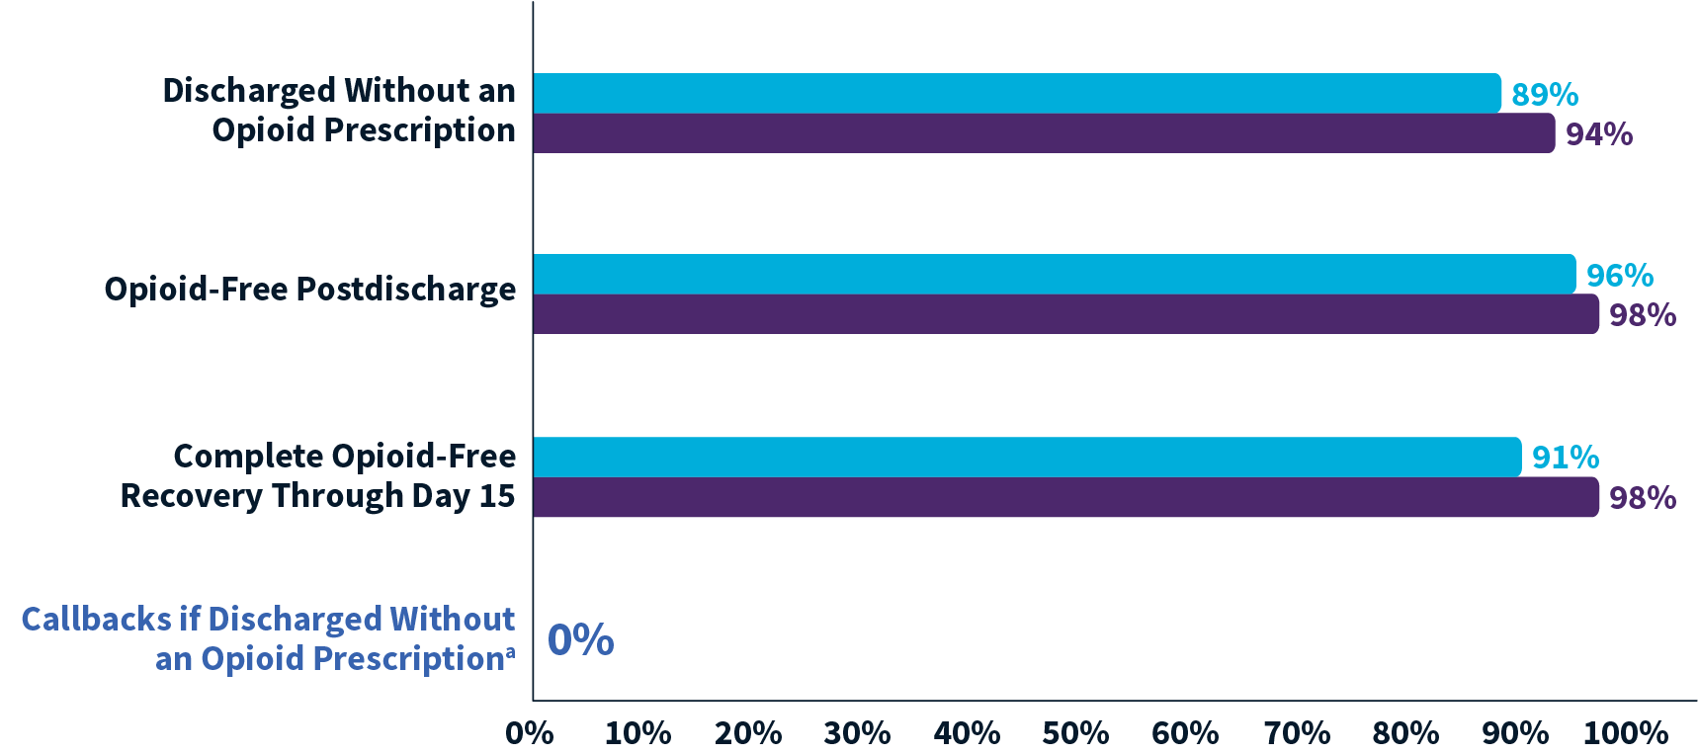
95% of ZYNRELEF Patients Opioid-Free Through Day 15 Recovery¹
THE HOPE PROJECT
Of open inguinal hernia repair patients treated with ZYNRELEF and a scheduled non-opioid oral OTC analgesic regimen (N = 93):
On average, patients were discharged 2.41 hours after surgery with only mild pain^{1,2}
Opioids were to be prescribed at discharge for patients who rated their pain at ≥6 (NRS) or received opioid rescue medication prior to discharge¹
ZYNRELEF Alternating^{b} MMA (n = 46)
ZYNRELEF Concurrent^{c} MMA (n = 47)
ªThrough day 15, 1 patient who received a discharge opioid prescription called the site for postoperative pain. ^{b}Alternating: OTC regimen of ibuprofen 600 mg q6h alternated 3 hours later with acetaminophen 1 g q6h. ^{c}Concurrent: OTC regimen of ibuprofen 600 mg and acetaminophen 1 g, taken together q6h.
OTC: over-the-counter. NRS: Numeric Rating Scale. MMA: multimodal analgesia. q6h: every 6 hours.
References: 1. Minkowitz H, Soto R, Fanikos J, et al. Opioid-free recovery after hernia repair with HTX-011 as the foundation of a non-opioid, multimodal analgesia regimen in a real-world setting: a randomized, open-label study. Pain Ther. 2021;10(2):1295-1308. doi:10.1007/s40122-021-00289-2. 2. Data on file. Study HTX-011-304. San Diego, CA: Heron Therapeutics Inc; 2020.
© 2023 Heron Therapeutics, Inc.

Slide 51
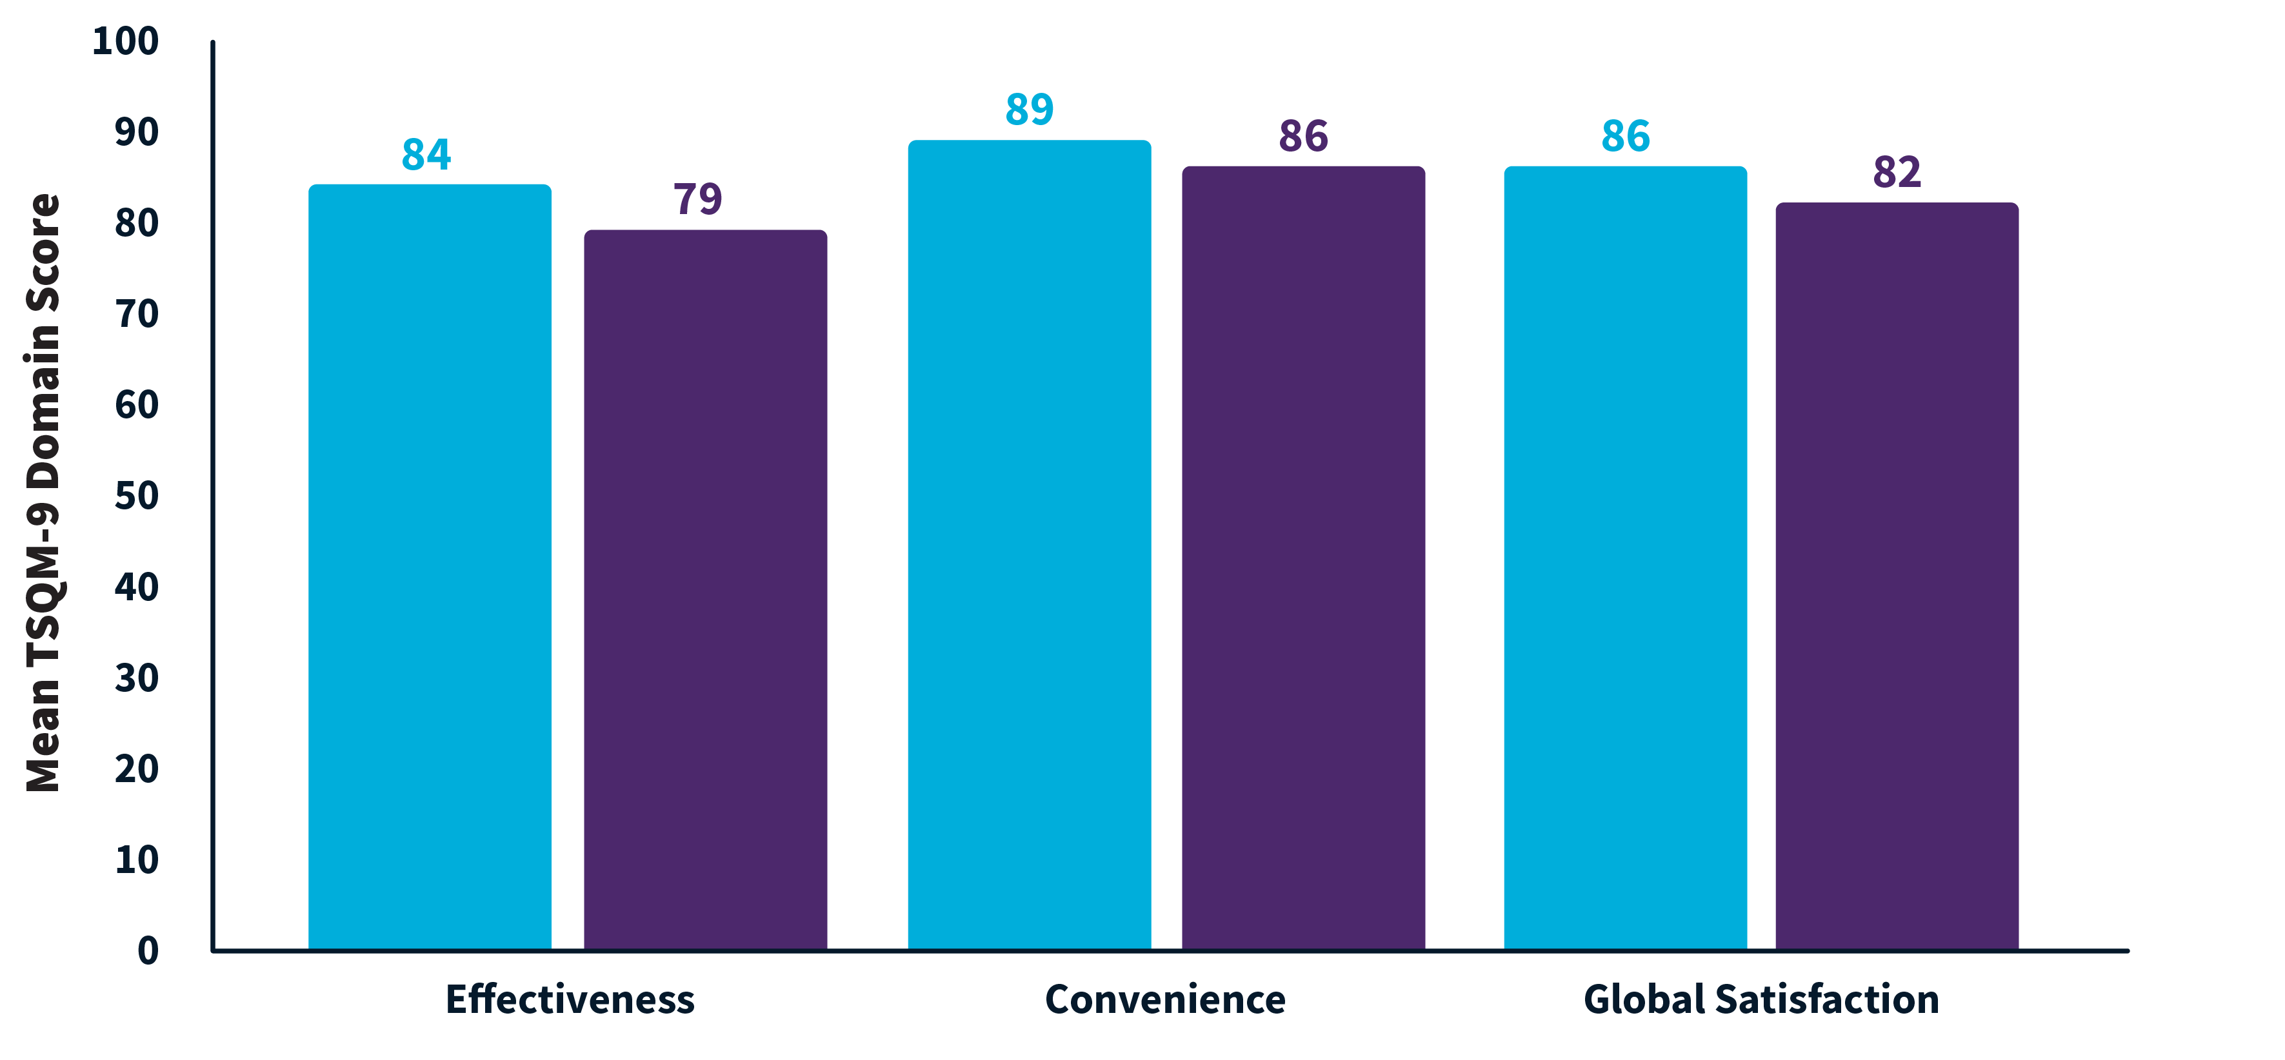
High Patient Satisfaction With Pain Relief in Both MMA Regimens¹
THE HOPE PROJECT
ZYNRELEF Alternatingª MMA (n = 46)
ZYNRELEF Concurrent^{b} MMA (n = 47)
ᵃAlternating: OTC regimen of ibuprofen 600 mg q6h alternated 3 hours later with acetaminophen 1 g q6h. ᵇConcurrent: OTC regimen of ibuprofen 600 mg and acetaminophen 1 g, taken together q6h.
Note: Satisfaction assessed at day 15.
MMA: multimodal analgesia. TSQM-9: Nine-item Treatment Satisfaction Questionnaire for Medication.² q6h: every 6 hours.
References: 1. Minkowitz H, Soto R, Fanikos J, et al. Opioid-free recovery after hernia repair with HTX-011 as the foundation of a non-opioid, multimodal analgesia regimen in a real-world setting: a randomized, open-label study. Pain Ther. 2021;10(2):1295-1308. doi:10.1007/s40122-021-00289-2. 2. Bharmal M, Payne K, Atkinson MJ, et al. Health Qual Life Outcomes. 2009;7:36.
© 2023 Heron Therapeutics, Inc.

Slide 52
HOPE Hernia 1: Incidence of Treatment-Emergent Adverse Events¹
THE HOPE PROJECT
 | Cohort 1: ZYNRELEF 300 mg/9 mg + Alternating MMA Regimenª (n = 46) | Cohort 2: ZYNRELEF 300 mg/9 mg + Concurrent MMA Regimen^{b} (n = 47)
Any AE | 28% | 38%
Nausea | 11% | 15%
Constipation | 2% | 9%
Vomiting | 7% | 4%
Severe AE | 0 | 0
Serious AE | 0 | 0
AE Leading to Study Withdrawal | 0 | 0
ᵃAlternating: OTC regimen of ibuprofen 600 mg q6h alternated 3 hours later with acetaminophen 1 g q6h. ᵇConcurrent: OTC regimen of ibuprofen 600 mg and acetaminophen 1 g, taken together q6h.
AE: adverse event. MMA: multimodal analgesia. Severe Adverse Event: any adverse event that interrupted daily activity or required systemic drug therapy or treatment. Serious Adverse Event: any adverse event that was life-threatening, resulted in substantial disruption to normal life, caused a birth defect, or required medical intervention. q6h: every 6 hours.
References: 1. Minkowitz H, Soto R, Fanikos J, et al. Opioid-free recovery after hernia repair with HTX-011 as the foundation of a non-opioid, multimodal analgesia regimen in a real-world setting: a randomized, open-label study. Pain Ther. 2021;10(2):1295-1308. doi:10.1007/s40122-021-00289-2.
© 2023 Heron Therapeutics, Inc.

Slide 53
Independent, Third-Party Research on ZYNRELEF
REAL-WORLD EVIDENCE
In addition to Heron’s clinical trials, independent third-party investigators have conducted real-world studies comparing ZYNRELEF with other treatments
© 2023 Heron Therapeutics, Inc.

Slide 54
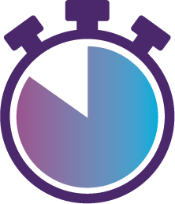
ZYNRELEF Versus Joint Cocktail in Primary TKA (Retrospective, Real-World Study): Reduced Severe Pain, Opioid Consumption, and Length of Stay¹
REAL-WORLD EVIDENCE
Independent, third-party, single-center, single-surgeon, retrospective chart review study.
Opioid Consumption
Primary outcomes: difference in pain scores (VAS) and 24-hour opioid consumption (MME).
All patients were opioid naive and received spinal and regional (adductor canal block^{b}) anesthesia as well as a standardized multimodal analgesic regimen.
Pain Relief
Length of Stay
45% lower pain scoresª (P < .001)
76% of ZYNRELEF patients experienced no severe pain (vs 45% for joint cocktail, P = .016)
53% lower opioid consumption (P < .05)
41% of ZYNRELEF patients were opioid free (vs 33% for joint cocktail, P = .053)
56% shorter length of stay (P < .05)
ZYNRELEF patients were discharged a day earlier on average
ZYNRELEF + Ropivacaine 50 mg (n = 29)
ZYNRELEF 400 mg/12 mg administered via instillation
Ropivacaine 50 mg administered as a periarticular injection
Joint Cocktail (n = 27)
100 mL periarticular injection of:
400 mg ropivacaine
30 mg ketorolac
0.6 mg epinephrine
0.5 mg hydromorphone or 5 mg morphine
Mean Pain Intensity Score (VAS)ª
Postoperative Opioid Consumption (MME/24 Hours)
Length of Stay (Hours)
ZYNRELEF 400 mg/12 mg + Ropivacaine 50 mg (n = 29)
Joint Cocktail (n = 27)
ZYNRELEF 400 mg/12 mg + Ropivacaine 50 mg (n = 29)
Joint Cocktail (n = 27)
ZYNRELEF 400 mg/12 mg + Ropivacaine 50 mg (n = 29)
Joint Cocktail (n = 27)
Note: The presented efficacy data is intended to comply with the FDA Guidance for Industry: Medical Product Communications That Are Consistent With the FDA-Required Labeling.
ªPain scores were assessed through time of discharge. ^{b}Adductor canal block of bupivacaine 0.5% 50 mg to 150 mg and ropivacaine LIA 0.5% 50 mg.
TKA: total knee arthroplasty. VAS: Visual Analog Scale. MME: morphine milligram equivalents. Severe pain: VAS score ≥7. LIA: local infiltration analgesia.
References: 1. Warner K, Bonkowski B, Melton K, Smith C, Turner A. Poster presented at: Orthopedics Today Hawaii; January 8-12, 2023; Koloa, HI.
© 2023 Heron Therapeutics, Inc.

Slide 55
Dosage and Administration
DOSAGE AND ADMINISTRATION
Single-dose instillation; applied via a needle-free syringe into the surgical site following final irrigation and suction and prior to suturing¹
Prepare and administer ZYNRELEF using only the components provided in the kit¹
No mixing with bupivacaine is required to achieve efficacy; ZYNRELEF should not be diluted¹
Other local anesthetics can be administered before ZYNRELEF without causing release of the active ingredients all at once.¹⁻³ The toxic effects of local anesthetics are additive. Avoid additional use of local anesthetics within 96 hours following administration of ZYNRELEF.
The recommended dose is based on the following factors¹:
For foot and ankle surgical procedures, such as bunionectomy: up to 2.3 mL to deliver 60 mg of bupivacaine and 1.8 mg of meloxicam
For small-to-medium open abdominal surgical procedures, such as open inguinal herniorrhaphy: up to 10.5 mL to deliver 300 mg of bupivacaine and 9 mg of meloxicam
For lower extremity total joint arthroplasty surgical procedures, such as total knee arthroplasty: up to 14 mL to deliver 400 mg of bupivacaine and 12 mg of meloxicam
References: 1. ZYNRELEF [package insert]. San Diego, CA: Heron Therapeutics Inc; 2021. 2. Viscusi E, Gimbel JS, Pollack RA, et al. Reg Anesth Pain Med. 2019;44(7):700-706. 3. Lachiewicz PF, Lee G-C, Pollak R, et al. J Arthroplasty. 2020;35(10):2843-2851.
© 2023 Heron Therapeutics, Inc.

Slide 56
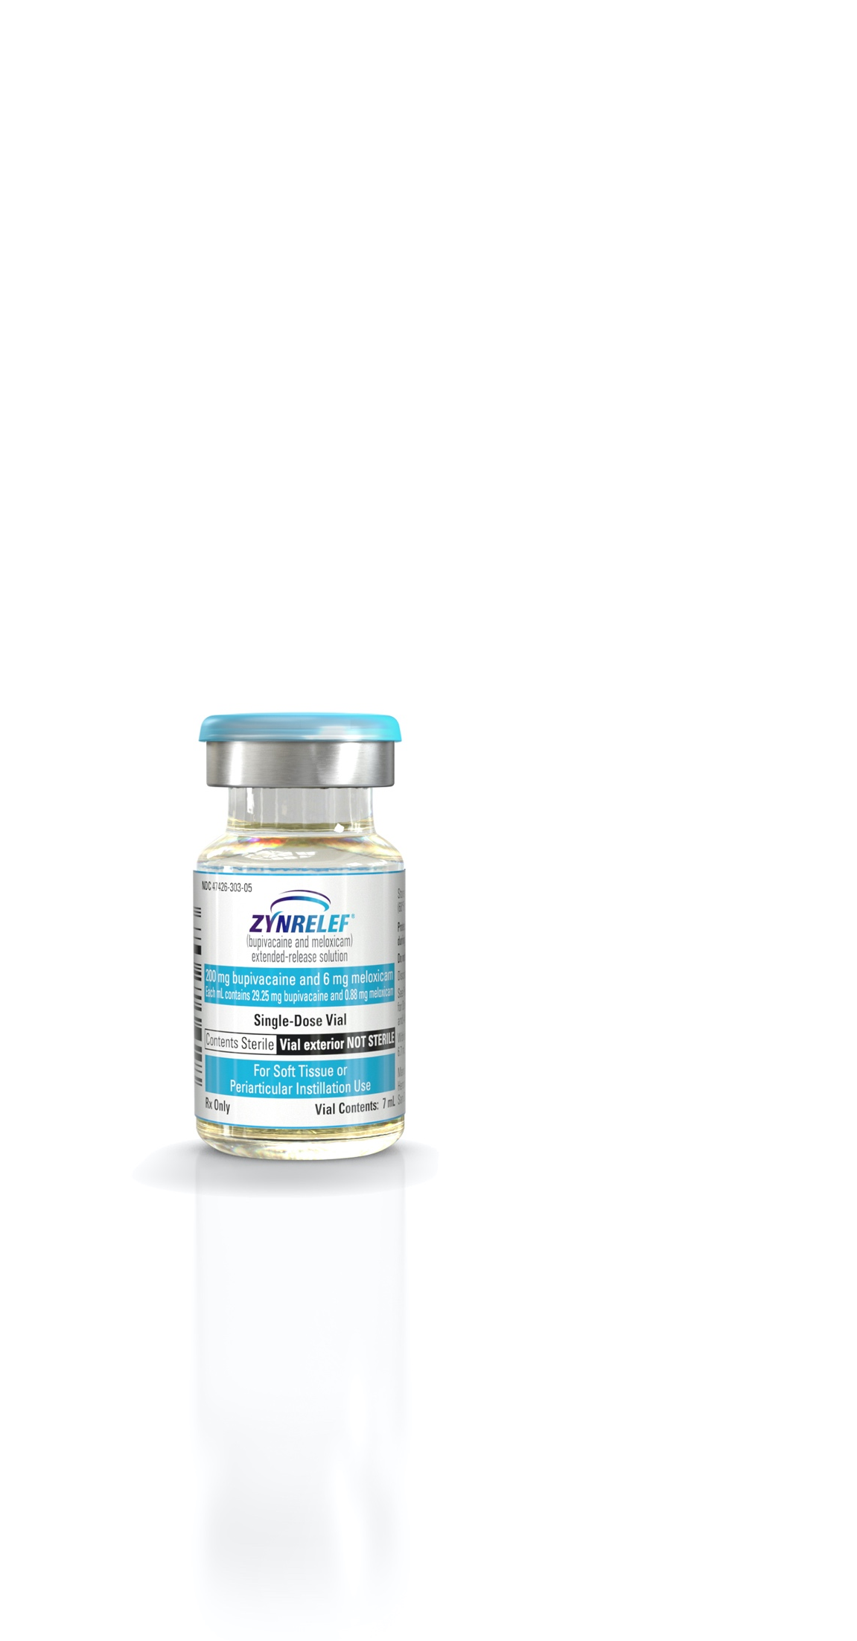
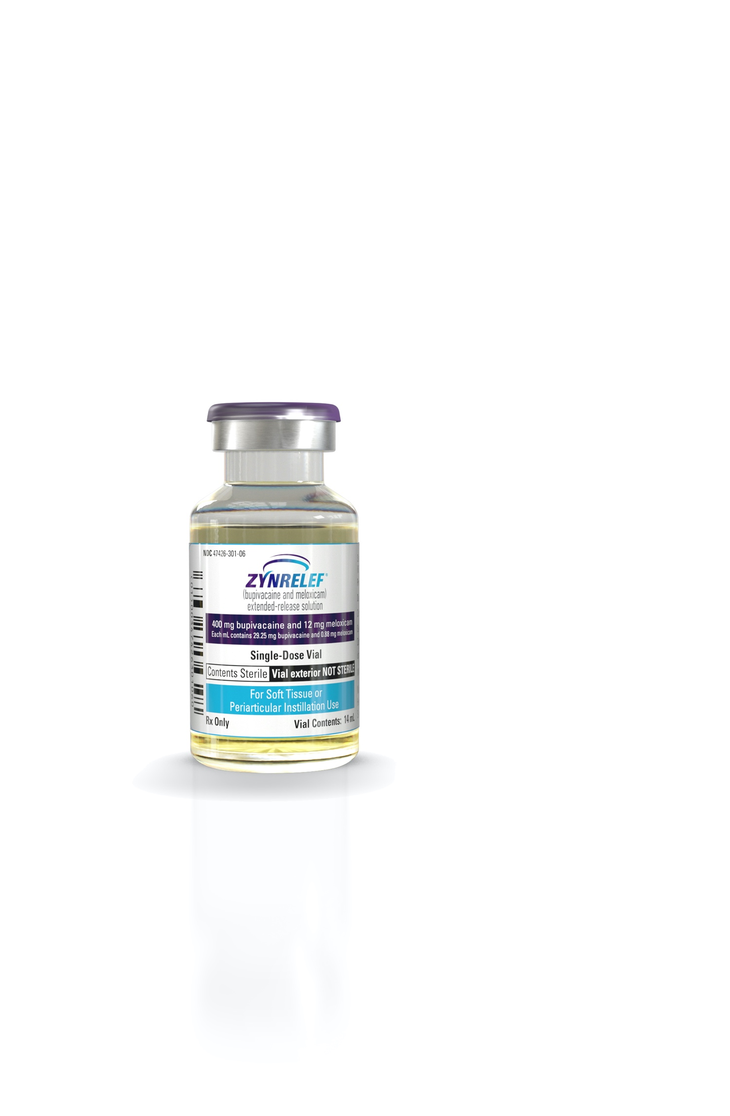
ZYNRELEF Is Available in 2 Volumes Suggested Vial Size for Example Procedures^{1,2}
DOSAGE AND ADMINISTRATION
The recommended vial is based on the size of the surgical site and the volume required to cover the tissues within the surgical site that could result in pain generation. Maximum total dose is 400 mg bupivacaine/12 mg meloxicam (14 mL).
14-mL Vial Size
Example Procedures • Appendectomy (Open)
• C-Section
• Herniorrhaphyª (Open)
• Hysterectomy (Open)
• Total Hip Arthroplasty • Total Knee Arthroplasty
7-mL Vial Size
Example Procedures • Bunionectomy and
Phalangectomy
• Female Sterilization • Fracture - Foot & Ankle
• Pelvic Floor Reconstruction
• Stoma Closure/Creation • Suburethral Sling
• Total Ankle Arthroplasty
Small-to-Medium Laparoscopic Extraction Site Example Procedures^{b}
• Appendectomy
• Cholecystectomy
• Colon and Small Bowel Resection
• Gastrectomy
• Hysterectomy
• Prostatectomy
• Roux-en-Y Gastric Bypass
Limit exposure to articular cartilage due to the potential risk of chondrolysis.
Note: Not all procedures listed under each vial size require full contents to cover affected tissues.
ªIncludes small-to-medium open hernia repair. ^{b}Extraction site is considered a small-to-medium open abdominal procedure.
References: 1. ZYNRELEF [package insert]. San Diego, CA: Heron Therapeutics Inc; 2021. 2. Data on file. Assessment of dose by procedure. San Diego, CA: Heron Therapeutics Inc; 2018.
© 2023 Heron Therapeutics, Inc.

Slide 57
In Vitro Release Rates of Active Ingredients¹
DOSAGE AND ADMINISTRATION
Maximum total dose: 400 mg bupivacaine/12 mg meloxicam (14 mL)
Bupivacaine 400 mg from ZYNRELEF
Meloxicam 12 mg from ZYNRELEF
100
100
90
90
80
80
70
Bupivacaine Released (%)
Meloxicam Released (mg)
70
Meloxicam Released (%)
60
60
50
50
40
40
30
30
20
20
10
10
0
0
Note: Milligram values extrapolated from in vitro release-rate percentages. ZYNRELEF was assayed in vitro.
References: 1. Data on file. Summary of biopharmaceutic studies and associated analytical methods. San Diego, CA: Heron Therapeutics Inc; 2018.
© 2023 Heron Therapeutics, Inc.

Slide 58
In Vitro Release Rates of Active Ingredients¹
DOSAGE AND ADMINISTRATION
Maximum total dose: 400 mg bupivacaine/12 mg meloxicam (14 mL)
Note: Milligram values extrapolated from in vitro release-rate percentages. ZYNRELEF was assayed in vitro.
References: 1. Data on file. Summary of biopharmaceutic studies and associated analytical methods. San Diego, CA: Heron Therapeutics Inc; 2018.
© 2023 Heron Therapeutics, Inc.

Slide 59
Packaging, Storage, and Handling
PACKAGING, STORAGE, AND HANDLING
Controlled room temperature 20°C to 25°C (68°F to 77°F)¹
Excursions permitted between 15°C to 30°C (59°F to 86°F)¹
36-month shelf life²
Distribution through full-line wholesalers and specialty distributors; prime vendor discounts apply
2 SKUs for different surgery requirements¹
SKUs identifiable by different colors on package
Kit includes all necessary components^{1,a}
Sized to fit in standard OR medication carts (eg, Pyxis™)
Kits have the same outer package dimensions
ªKit components include single-dose glass vial, Luer lock syringe(s), vented vial spike, Luer lock applicator(s), and tip cap(s). SKU: stock keeping unit.
References: 1. ZYNRELEF [package insert]. San Diego, CA: Heron Therapeutics Inc; 2021. 2. Roca R; Center for Drug Evaluation and Research. https://www.accessdata.fda.gov/drugsatfda_docs/appletter/2021/211988Orig1s000ltr.pdf. Accessed May 13, 2021.
© 2023 Heron Therapeutics, Inc.

Slide 60
Packaging, Storage, and Handling (cont)
PACKAGING, STORAGE, AND HANDLING
Product Presentation¹ |  |  | Vented Vial Spike | Luer Lock Syringe(s) | Luer Lock Applicator(s) | Syringe Tip Cap(s)
NDC | Bupivacaine/ Meloxicam | Volume
47426-301-02 | 400 mg/12 mg | 14 mL | 1 | 2 x 12 mL | 2 | 2
47426-303-01 | 200 mg/6 mg | 7 mL | 1 | 1 x 12 mL | 1 | 1
Order Replacement Kit Components for ZYNRELEF
ZYNRELEF should be prepared and administered using only the components provided in the ZYNRELEF kit.
In case parts are dropped or mishandled during preparation, replacement kit components can be ordered for $0.01 per carton. Search “ZYNRELEF” on your distributor’s ordering website and add 1 carton of each componentª to your initial order.
ªLuer lock cone-shaped applicators (GTIN 00347426902106), vented vial spikes (GTIN 00347426903059), 12-mL Luer lock syringes (GTIN 00347426904087).
References: 1. ZYNRELEF [package insert]. San Diego, CA: Heron Therapeutics Inc; 2021.
© 2023 Heron Therapeutics, Inc.

Slide 61
ZYNRELEF Is Priced to Reduce Average Cost Across the Surgical Mix
ZYNRELEF UNIT PRICING
ZYNRELEF Pricingª
SKU | WAC | 340B^{b}
14 mL: 400 mg/12 mg | $280.87 | $204.49
7 mL: 200 mg/6 mg | $142.27 | $103.31
Cost Information for Other Longer-Acting Local Anesthetics
Exparel^{®c,d}
Not including bupivacaine cost
WAC
340B
Cost comparisons do not imply safety or efficacy. WAC and list prices may not reflect discounts available to customers through manufacturers or other parties.
20 mL $365.16
10 mL $214.75
$266.00
$151.00
Catheter-based pump cost^{1,e}
$318-$630
GPO and sub-WAC discounts available. Prime vendor discounts apply.
ZYNRELEF Estimated Average Cost, SKU Mix, and Savings by Setting of Care Compared With Exparel
 | ZYNRELEF^{2,a,f} | ZYNRELEF |  | Exparel^{3,d,g} |  |  | Estimated Savings With ZYNRELEF
 | Estimated Average Cost | Estimated SKU Mix |  | Average Cost | SKU Mix |  | Estimated ZYNRELEF Savings
 |  | 400 mg | 200 mg |  | 20 mL | 10 mL
Hospital | ~$187 | 32% | 68% | ~$321 | 71% | 29% | 42%
ASC | ~$170 | 20% | 80% | ~$287 | 48% | 52% | 41%
ªZYNRELEF pricing as of January 1, 2023. 340B prices update quarterly. Confirm current pricing with your Heron representative. ^{b}340B pricing allows purchases by eligible customers for outpatient use at a minimum discount of 23.1%. ^{c}Exparel (bupivacaine liposome injectable suspension) is a trademark of Pacira Pharmaceuticals, Inc. ^{d}Figures reflect Exparel prices as of January 1, 2023. ^{e}Pump cost varies based on components, drug, and rate of delivery. ^{f}Based on national average procedure volumes for common procedures; individual organizations may vary. Estimated average cost at WAC; not inclusive of GPO, sub-WAC, or distributor discounts. ^{g}Estimated average cost at WAC.
SKU: stock keeping unit. WAC: wholesale acquisition cost. GPO: group purchasing organization. ASC: ambulatory surgical center.
References: 1. Data on file. On-Q competitive intelligence. San Diego, CA: Heron Therapeutics Inc; 2019. 2. Data on file. DRG procedure volume analysis. San Diego, CA: Heron Therapeutics Inc; 2020. 3. US non-retail pharmacy sales data, January-December 2022. Horsham, PA: Symphony Health; 2023.
© 2023 Heron Therapeutics, Inc.

Slide 62
ZYNRELEF Reimbursement Overview
REIMBURSEMENT
C9088
Medicare: ZYNRELEF Is Reimbursed Separately in HOPDs and ASCs Through 2027
HOPD, ASC: Separate Payment Through 2027 (Medicare)
Through March 2025
HOPD, ASC: Separate reimbursement at ASP + 6% (pass-through status)
Commercial: Separate Payment Available for Many Patients
April 2025 – December 2027
HOPD, ASC: Separate reimbursement under law promoting access to non-opioids (HR 2617 §4135, signed December 2022)
Commercial payers have been notified that C9088 has been assigned for ZYNRELEF; many customers have reported separate commercial payment
Commercial reimbursement varies by payer and site of care; contact payers to verify coverage
Heron offers resources to assist with billing and coding and to support separate payment requests
2023 Q1 Medicare Reimbursement and Pricing
ZYNRELEF | Medicare Reimbursement (Allowed Amount)^{a,b} | Pricing^{c}
SKU | HOPD, ASC | WAC | 340B
14 mL: 400 mg/12 mg | $276.00 | $280.87 | $204.49
7 mL: 200 mg/6 mg | $138.00 | $142.27 | $103.31
Note: Outpatient procedures include those expected to require a hospital stay spanning less than 2 midnights.
Exparel is not currently separately reimbursed in the HOPD.^{d} Pumps and generic local anesthetics like bupivacaine HCl are currently packaged across all settings of care.^{e}
ªHOPD coverage under 3-year transitional pass-through status (effective April 1, 2022). ^{b}Q1 2023 Medicare payment rate: ZYNRELEF $0.69/mg. Medicare reimbursement is subject to CMS updates, co-pay amounts, sequestration, and other factors. ^{c}ZYNRELEF pricing as of January 1, 2023. 340B prices update quarterly. Confirm current pricing with your Heron representative. ^{d}From January 1, 2025 through December 31, 2027, Medicare will reimburse separately in HOPDs and ASCs for certain non-opioid drugs without pass-through status, per HR 2617 §4135. ^{e}Reimbursement comparisons do not imply safety or efficacy.
HOPD: hospital outpatient department. ASC: ambulatory surgical center. ASP: average sales price. SKU: stock keeping unit. WAC: wholesale acquisition cost. CMS: Centers for Medicare & Medicaid Services.
© 2023 Heron Therapeutics, Inc.

Slide 63
Q1 2023 Medicare Reimbursement by SKU: ZYNRELEF vs Exparel^{®a}
REIMBURSEMENT
ZYNRELEF is separately reimbursed in HOPDs by Medicare, Exparel currently is not^{b}
ZYNRELEF | Medicare Reimbursement (Allowed Amount)^{b,c} | Pricing^{d}
SKU | HOPD, ASC | WAC | 340B
14 mL: 400 mg/12 mg | $276.00 | $280.87 | $204.49
7 mL: 200 mg/6 mg | $138.00 | $142.27 | $103.31
Exparel | Medicare Reimbursement (Allowed Amount)^{c} |  | Pricing^{e}
SKU | HOPD | ASC | WAC | 340B
266 mg (20 mL) | Packaged | $367.08 | $365.16 | $266.00
133 mg (10 mL) | Packaged | $183.54 | $214.75 | $151.00
Cost and reimbursement comparisons do not imply safety or efficacy. WAC and list prices may not reflect discounts available to customers through manufacturers or other parties.
ªExparel (bupivacaine liposome injectable suspension) is a trademark of Pacira Pharmaceuticals, Inc. ^{b}ZYNRELEF HOPD coverage under 3-year transitional pass-through status (effective April 1, 2022). ^{C}Q1 2023 Medicare payment rate: ZYNRELEF $0.69/mg, Exparel $1.38/mg. Medicare reimbursement is subject to CMS updates, co-pay amounts, sequestration, and other factors. ^{d}ZYNRELEF pricing as of January 1, 2023. 340B prices update quarterly. Confirm current pricing with your Heron representative. ^{e}Exparel prices as of January 1, 2023.
SKU: stock keeping unit. HOPD: hospital outpatient department. ASC: ambulatory surgical center. WAC: wholesale acquisition cost. CMS: Centers for Medicare & Medicaid Services.
© 2023 Heron Therapeutics, Inc.

Slide 64
Important Safety Information
WARNING: RISK OF SERIOUS CARDIOVASCULAR AND GASTROINTESTINAL EVENTS
Nonsteroidal anti-inflammatory drugs (NSAIDs) cause an increased risk of serious cardiovascular thrombotic events, including myocardial infarction and stroke, which can be fatal. This risk may occur early in treatment and may increase with duration of use.
ZYNRELEF is contraindicated in the setting of coronary artery bypass graft (CABG) surgery.
NSAIDs cause an increased risk of serious gastrointestinal (GI) adverse events including bleeding, ulceration, and perforation of the stomach or intestines, which can be fatal. These events can occur at any time during use and without warning symptoms. Elderly patients and patients with a prior history of peptic ulcer disease and/or GI bleeding are at greater risk for serious GI events.
Contraindications
ZYNRELEF is contraindicated in patients with a known hypersensitivity (eg, anaphylactic reactions and serious skin reactions) to any amide local anesthetic, NSAIDs, or other components of ZYNRELEF; with history of asthma, urticaria, or other allergic-type reactions after taking aspirin or other NSAIDs (severe, sometimes fatal, anaphylactic reactions to NSAIDS have been reported in such patients); undergoing obstetrical paracervical block anesthesia; or undergoing CABG.
© 2023 Heron Therapeutics, Inc.

Slide 65
Important Safety Information (cont)
Warnings and Precautions
Dose-Related Toxicity: Monitor cardiovascular and respiratory vital signs and patient’s state of consciousness after application of ZYNRELEF. When using ZYNRELEF with other local anesthetics, overall local anesthetic exposure must be considered through 72 hours.
Hepatotoxicity: If abnormal liver tests persist or worsen, perform a clinical evaluation of the patient.
Hypertension: Patients taking some antihypertensive medication may have impaired response to these therapies when taking NSAIDs. Monitor blood pressure.
Heart Failure and Edema: Avoid use of ZYNRELEF in patients with severe heart failure unless benefits are expected to outweigh risk of worsening heart failure.
Renal Toxicity: Monitor renal function in patients with renal or hepatic impairment, heart failure, dehydration, or hypovolemia. Avoid use of ZYNRELEF in patients with advanced renal disease unless benefits are expected to outweigh risk of worsening renal failure.
© 2023 Heron Therapeutics, Inc.

Slide 66
Important Safety Information (cont)
Warnings and Precautions (cont)
Anaphylactic Reactions: Seek emergency help if an anaphylactic reaction occurs.
Chondrolysis: Limit exposure to articular cartilage due to the potential risk of chondrolysis.
Methemoglobinemia: Cases have been reported with local anesthetic use.
Serious Skin Reactions: NSAIDs, including meloxicam, can cause serious skin adverse reactions. If symptoms present, evaluate clinically.
Drug Reaction with Eosinophilia and Systemic Symptoms (DRESS): If symptoms are present, evaluate clinically.
Fetal Toxicity: Due to the risk of oligohydramnios/fetal renal dysfunction and premature closure of the ductus arteriosus with NSAIDS, limit use of ZYNRELEF between about 20 to 30 weeks gestation, and avoid use after about 30 weeks.
Hematologic Toxicity: Monitor hemoglobin and hematocrit in patients with any signs or symptoms of anemia.
© 2023 Heron Therapeutics, Inc.

Slide 67
Important Safety Information (cont)
Drug Interactions
Drugs That Interfere with Hemostasis: Monitor patients for bleeding who are using ZYNRELEF with drugs that interfere with hemostasis (eg, warfarin, aspirin, SSRIs/SNRIs).
ACE Inhibitors, Angiotensin Receptor Blockers (ARBs), or Beta-Blockers: Use with ZYNRELEF may diminish the antihypertensive effect of these drugs. Monitor blood pressure.
ACE Inhibitors and ARBs: Use with ZYNRELEF in elderly, volume-depleted, or those with renal impairment may result in deterioration of renal function. In such high-risk patients, monitor for signs of worsening renal function.
Diuretics: NSAIDs can reduce natriuretic effect of furosemide and thiazide diuretics. Monitor patients to assure diuretic efficacy including antihypertensive effects.
© 2023 Heron Therapeutics, Inc.

Slide 68
Important Safety Information (cont)
Use in Specific Populations
Infertility: NSAIDs are associated with reversible infertility. Consider avoidance of ZYNRELEF in women who have difficulties conceiving.
Severe Hepatic Impairment: Only use if benefits are expected to outweigh risks; monitor for signs of worsening liver function.
Severe Renal Impairment: Not recommended.
Adverse Reactions
Most common adverse reactions (incidence ≥10%) in controlled clinical trials with ZYNRELEF are constipation, vomiting, and headache.
Report side effects to Heron at 1-844-437-6611 or to FDA at 1-800-FDA-1088 or www.fda.gov/medwatch.
Please see full Prescribing Information, including Boxed Warning, at ZYNRELEF.com.
© 2023 Heron Therapeutics, Inc.

Slide 69
Thank You
PP-HTX011-0371 | 03/23
© 2023 Heron Therapeutics, Inc.

